Slide 1
What feeds your decision making? Phil Kelly – Performance Director
Notes:
Background to Pro-Noctis and Phil Kelly

Slide 2
Pro Who….????
Notes:
Who are we?

Slide 3
Notes:
Our relationship with ShipMoney, Development, soft skills, sales, Consultancy advice etc

Slide 4
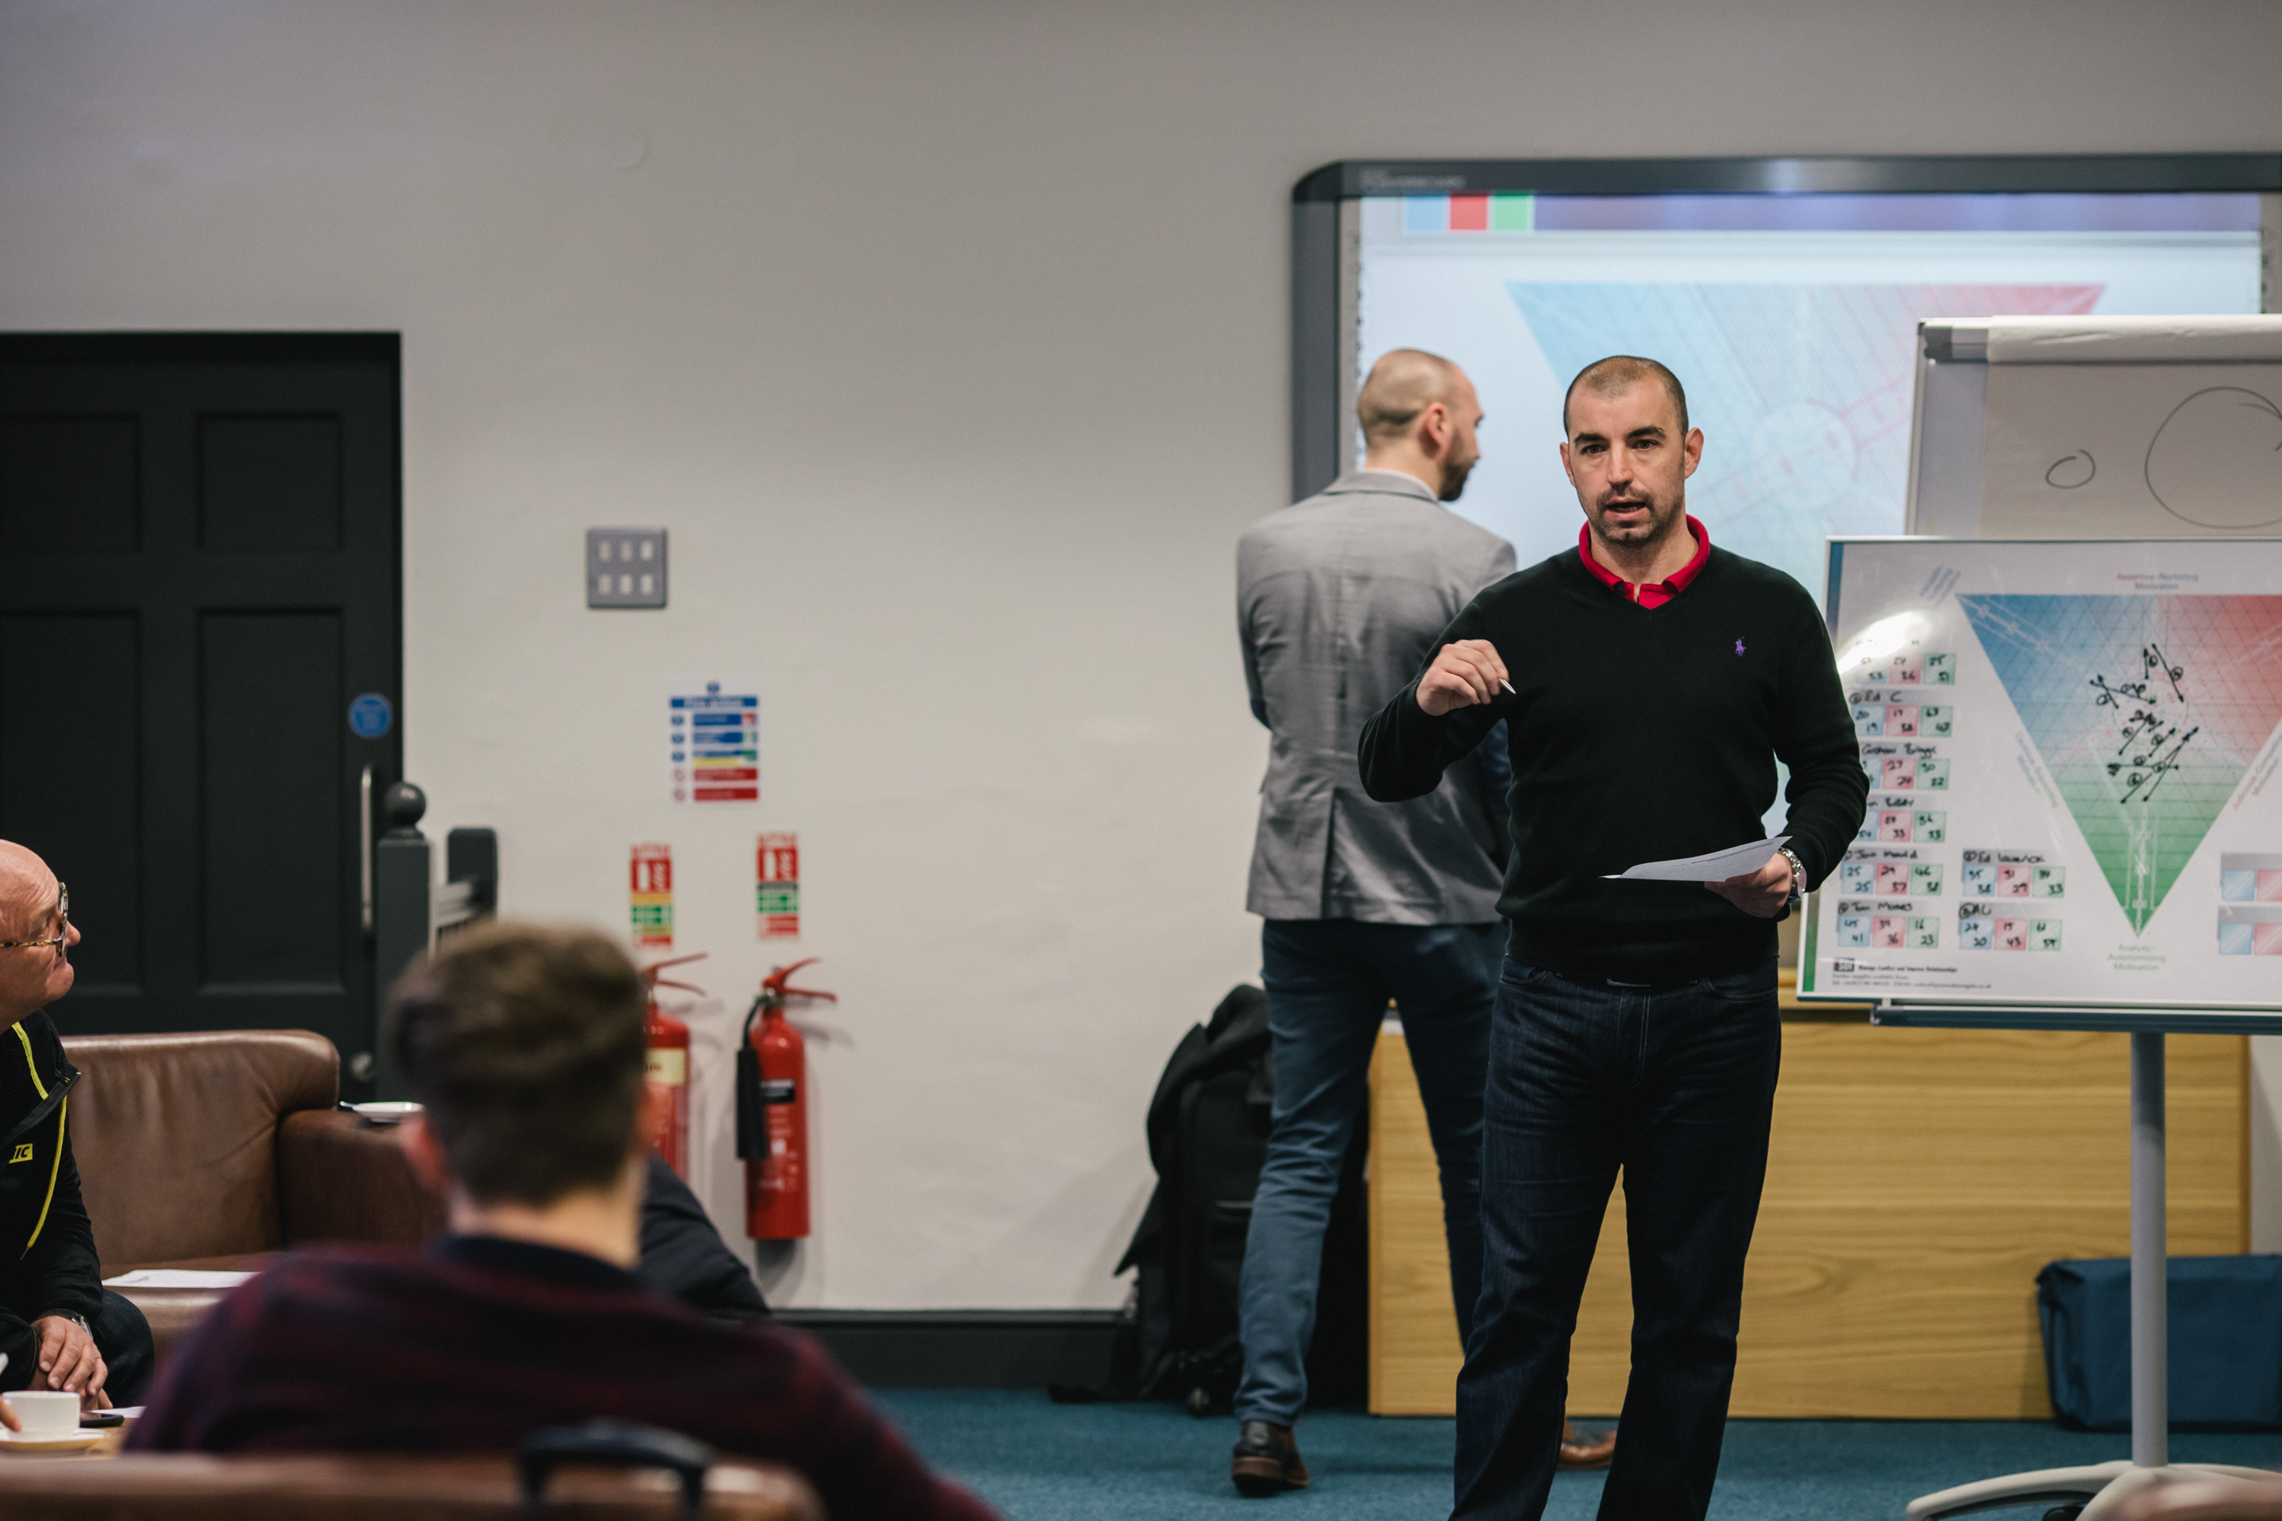
Notes:
Example of projects

Slide 5
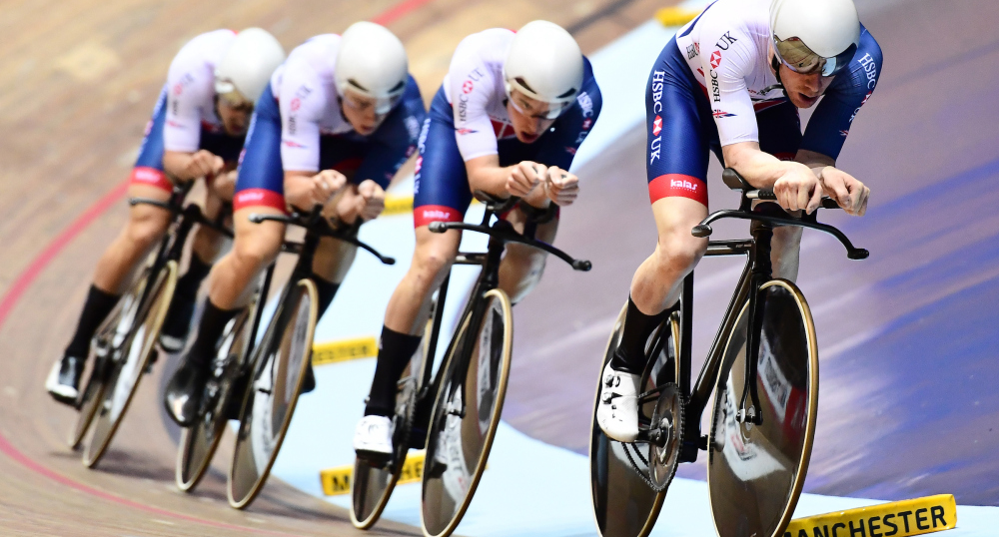
Notes:
Working with High performing teams and organisations

Slide 6
Corporate Experience
Elite Sports Coaching
Military Expertise
=
Ability to Bespoke
Notes:
How?, What? Why?
Anecdotal story from the Military around indecision.

Slide 7
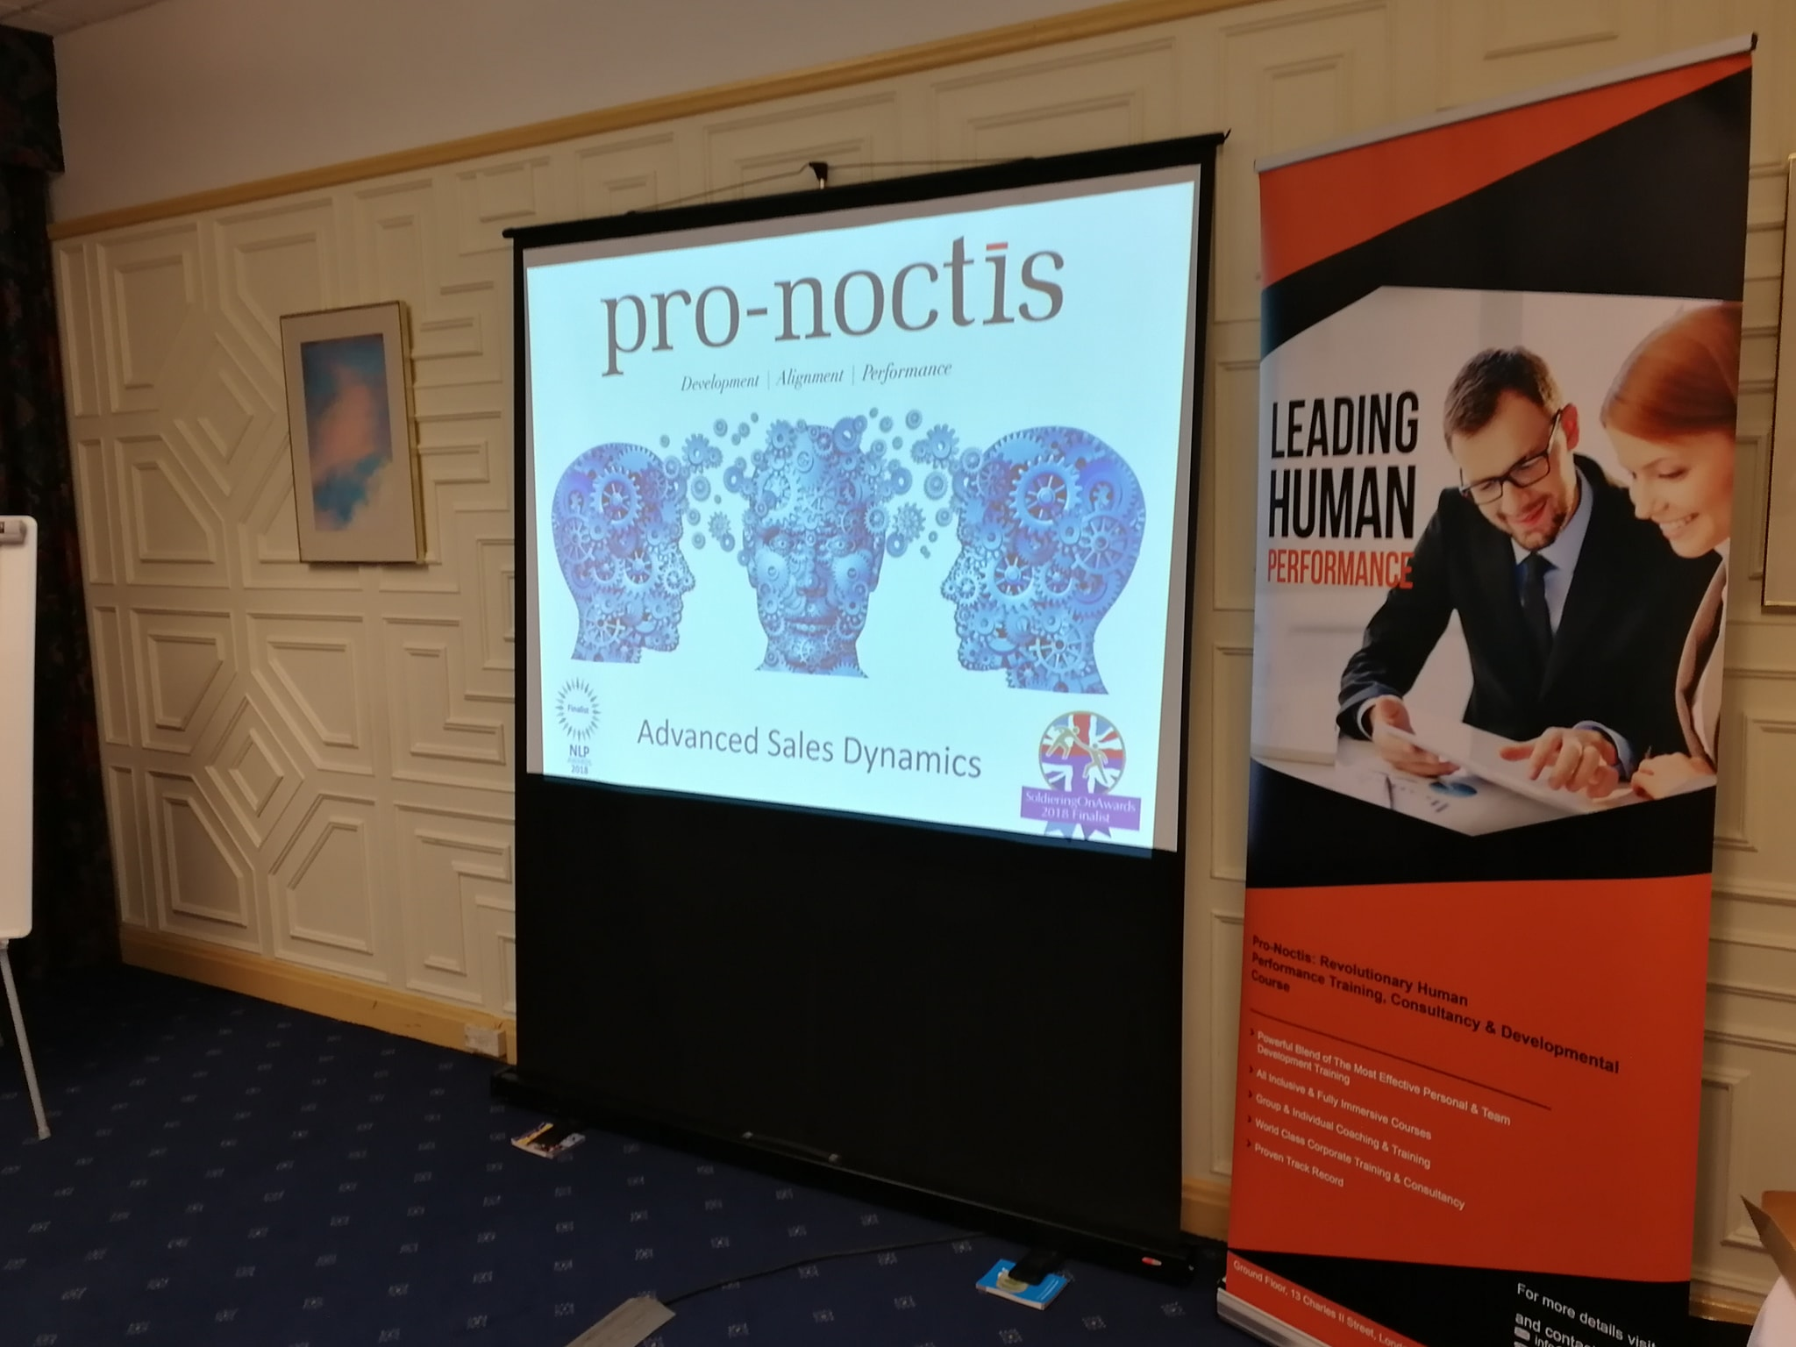
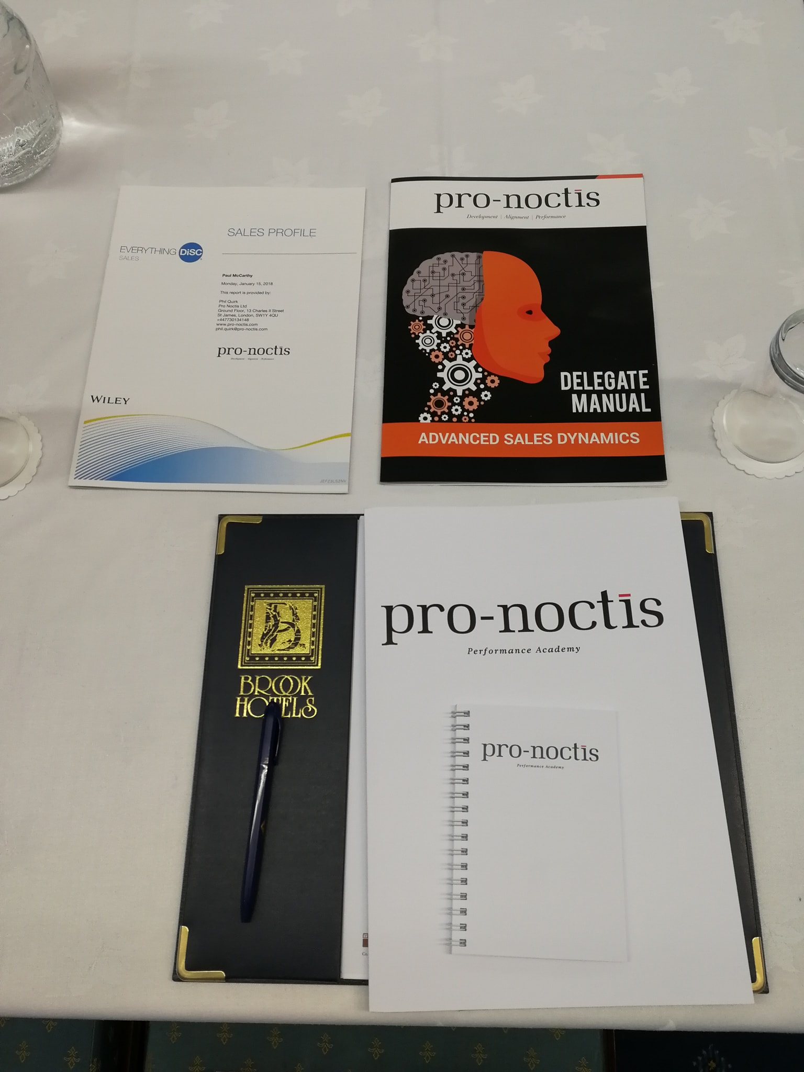
Sales Dynamics Training
Notes:
For example we have designed bespoke training for our clients…..Sales, Organisational development, Difficult conversations.

Slide 8
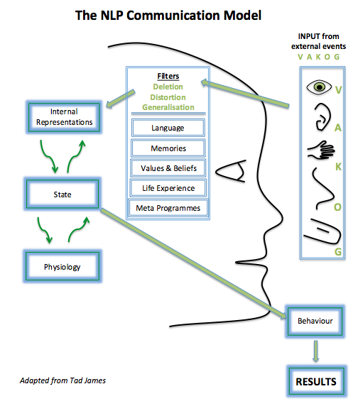
Notes:
How many decisions do you think we make every single day?
To understand how we make decisions we first have to understand how we process information…….

Slide 9
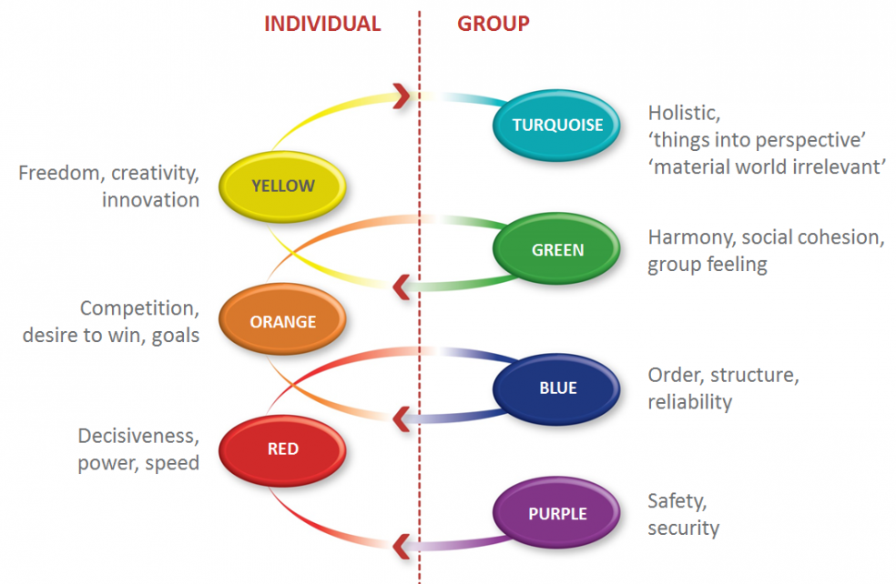
Notes:
Values as a filter
Then we need to understand who we are as an individual and our own personal values, what drives our decisions, therefore our behaviour and personality.

Slide 10
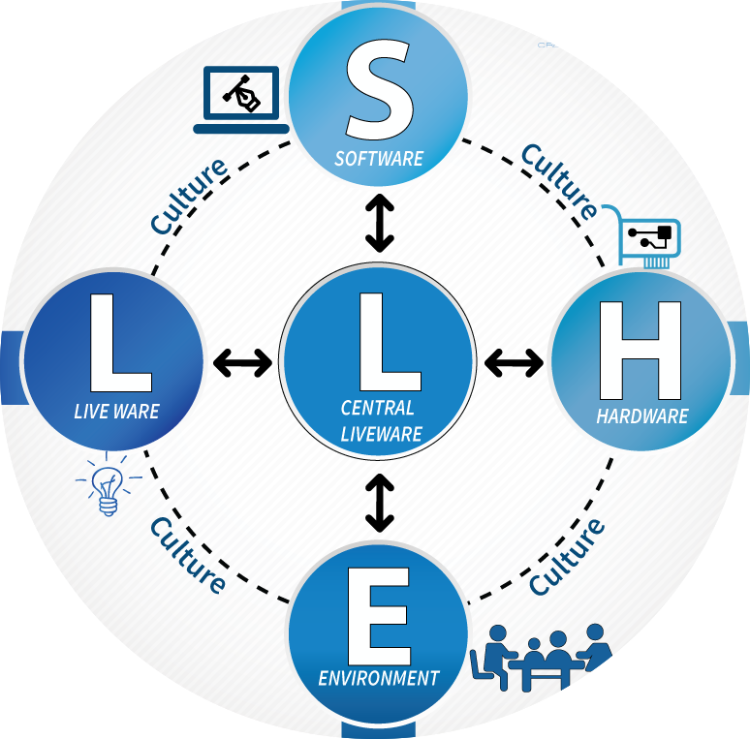
Notes:
Then we need to understand the environment we are in and which parts draw our attention and therefore our feed our biases.

Slide 11
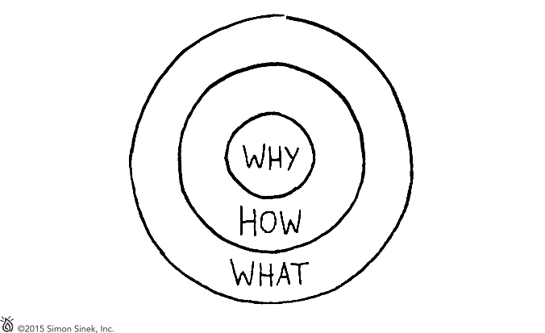
The Golden Circle
Notes:
To review our decision making to ensure learning takes place, whether good, bad or indifferent we need to understand why.
It’s all about the intention not the behaviour.

Slide 12
Cross Industry
Learning
Do we learn internally within our industry and can we learn from other industry's?

Slide 13
Panel Discussion

