Slide 1
InterManager
F E B R U A R Y 2 0 1 8

Slide 2
WE MAKE MONEY EASY.
Simplify global crew payments
Reduce payment and remittance costs
Minimize onboard cash
Empower crew members
Unparalleled client support
Alleviate complicated administrative procedures
GLOBAL PAYMETS DISTRIBUTION

Slide 3
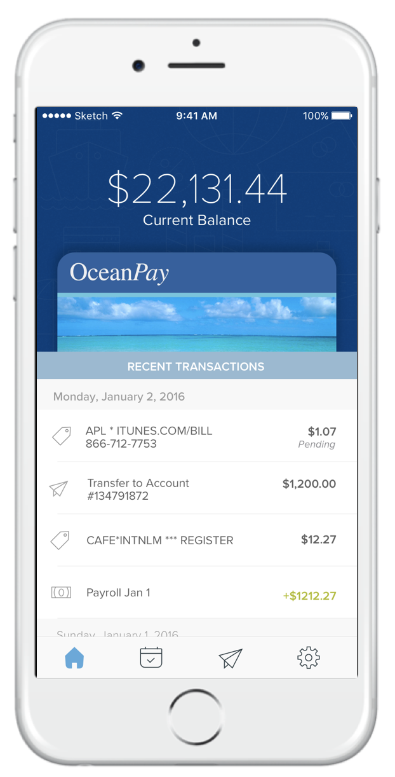
WE MAKE MONEY EASY.
Brightwell
Who we are
Established 2001
Largest program in maritime industry
Research & Solutions
Years of focus groups
Thousand of one on one crew interviews
Mobile app
Allows ease of use
Empowers crew

Slide 4
RESEARCH
Most crew fall into three areas when it comes to their pay
Young, single and not necessarily working toward a specific goal or plan. Tend to leave money on their card. Travel inspires them.
Actively support family back home. Need to get money there to pay bills.
Want to send money home but have the luxury to watch rates and send at optimal times.

Slide 5
RESEARCH
Crew welfare and the issues they face
Lack of ability to control their funds in a timely manner
Poor usability of local debit card overseas
Lack of ability to capitalize on USD local currency exchange rates
Risk of losing their cash – once it’s lost it’s lost

Slide 6
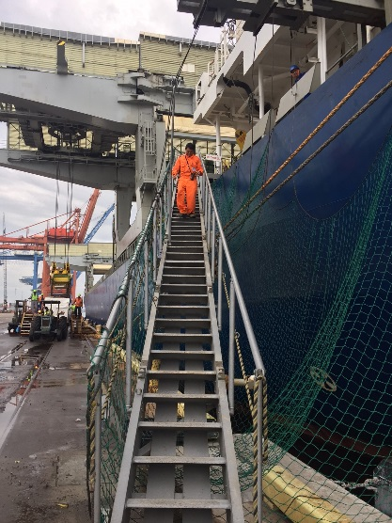
WHY OCEANPAY
Save Money
Save Time
Choice and Control
Security

Slide 7
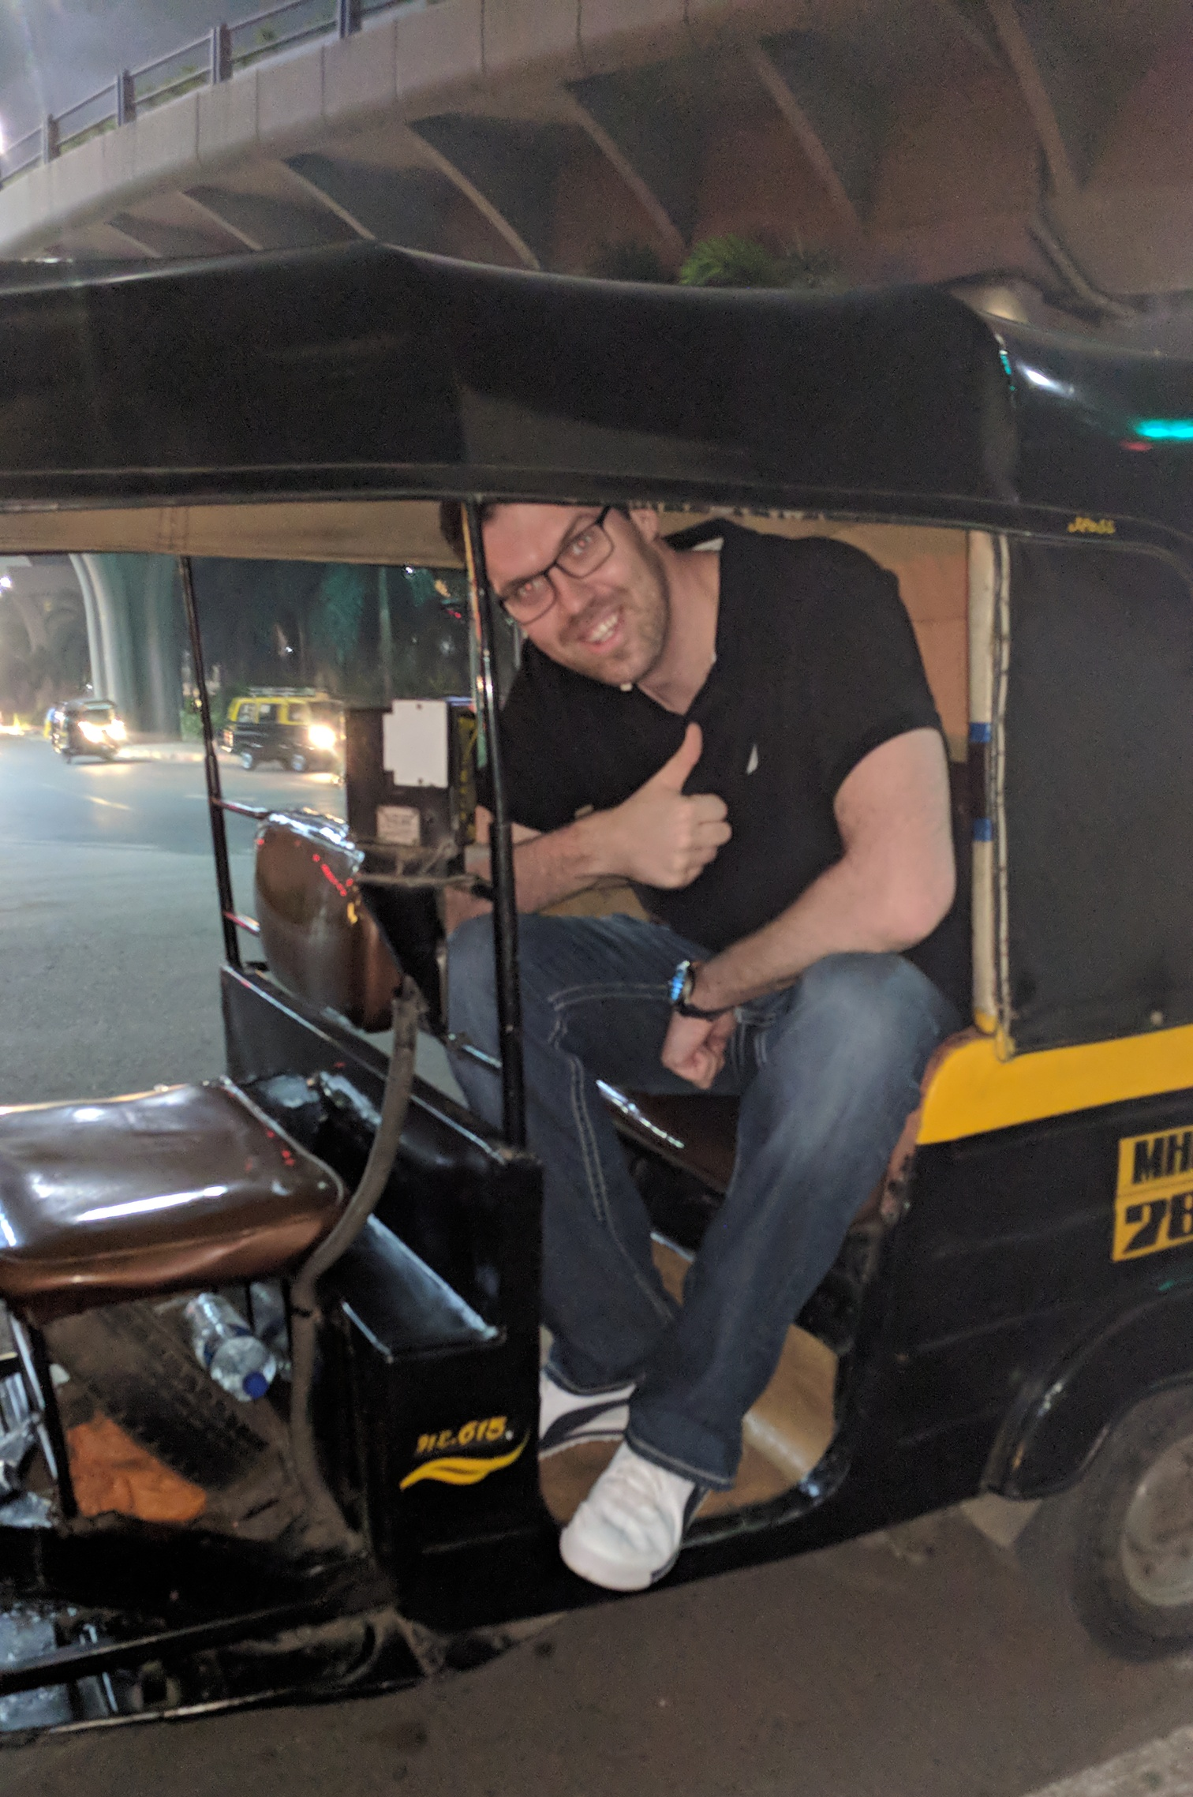
BRIGHTWELL HAS BEEN SUCCESSFUL INTRODUCING TECHNOLOGY IN A CONSERVATIVE INDUSTRY
Partnership
Crew Focused
Implementation
Communication
Continual Development

Slide 8
CARD SPEND
Notes:
Factors of Influence
ATM
Proximity/Accessibility to an ATM or Bank
Preference of family
Habit/tendency to use cash over card
Remittances
Transfer fee, Currency Exchange Rates, Speed of Remittance, Ease of service, Availability of Currency Exchange Rate and Country
Availability of options - Cashpickup/Transfer to bank account
Speed of remittance
Ease of service
Reputation of the Remittance service
Crew Recommendations - Word of Mouth
Other
Individual choices
Family needs
Crew Recommendations about products/prices/merchants

Slide 9
CREW SPEND
MCC codes categories that make up OceanPay spending
9
8
7
Specialty Retail
Drug Stores & Pharmacies
Restaurants
Amazon Marketplace
Sunglass Hut
Walgreens
CVS Pharmacy
Chili’s
McDonald’s

Slide 10
CREW SPEND
MCC codes categories that make up OceanPay spending
6
5
4
Discount Stores
Family Clothing Stores
Electronic Sales
Ross Stores
Walmart
GAP
H&M
Apple Store
Seafarers Electronics

Slide 11
CREW SPEND
MCC codes categories that make up OceanPay spending
3
2
1
Grocery Stores
Book Stores
Computer Services
Walmart
Sam’s Club
Mega Supermarket
Amazon.com
Books a Million
Amazon.com
Microsoft
T-Mobile

Slide 12
Thank you
REDUCING COSTS, DRIVING EFFENCIES & EMPOWERING CREW

