Slide 1
The Necessity for Standardisation in the Maritime Industry
Capt. Timothy Crowch
Intermanager – 13th September 2013 - London

Slide 2
The Organisational Accident
Prof. James Reason

Slide 3
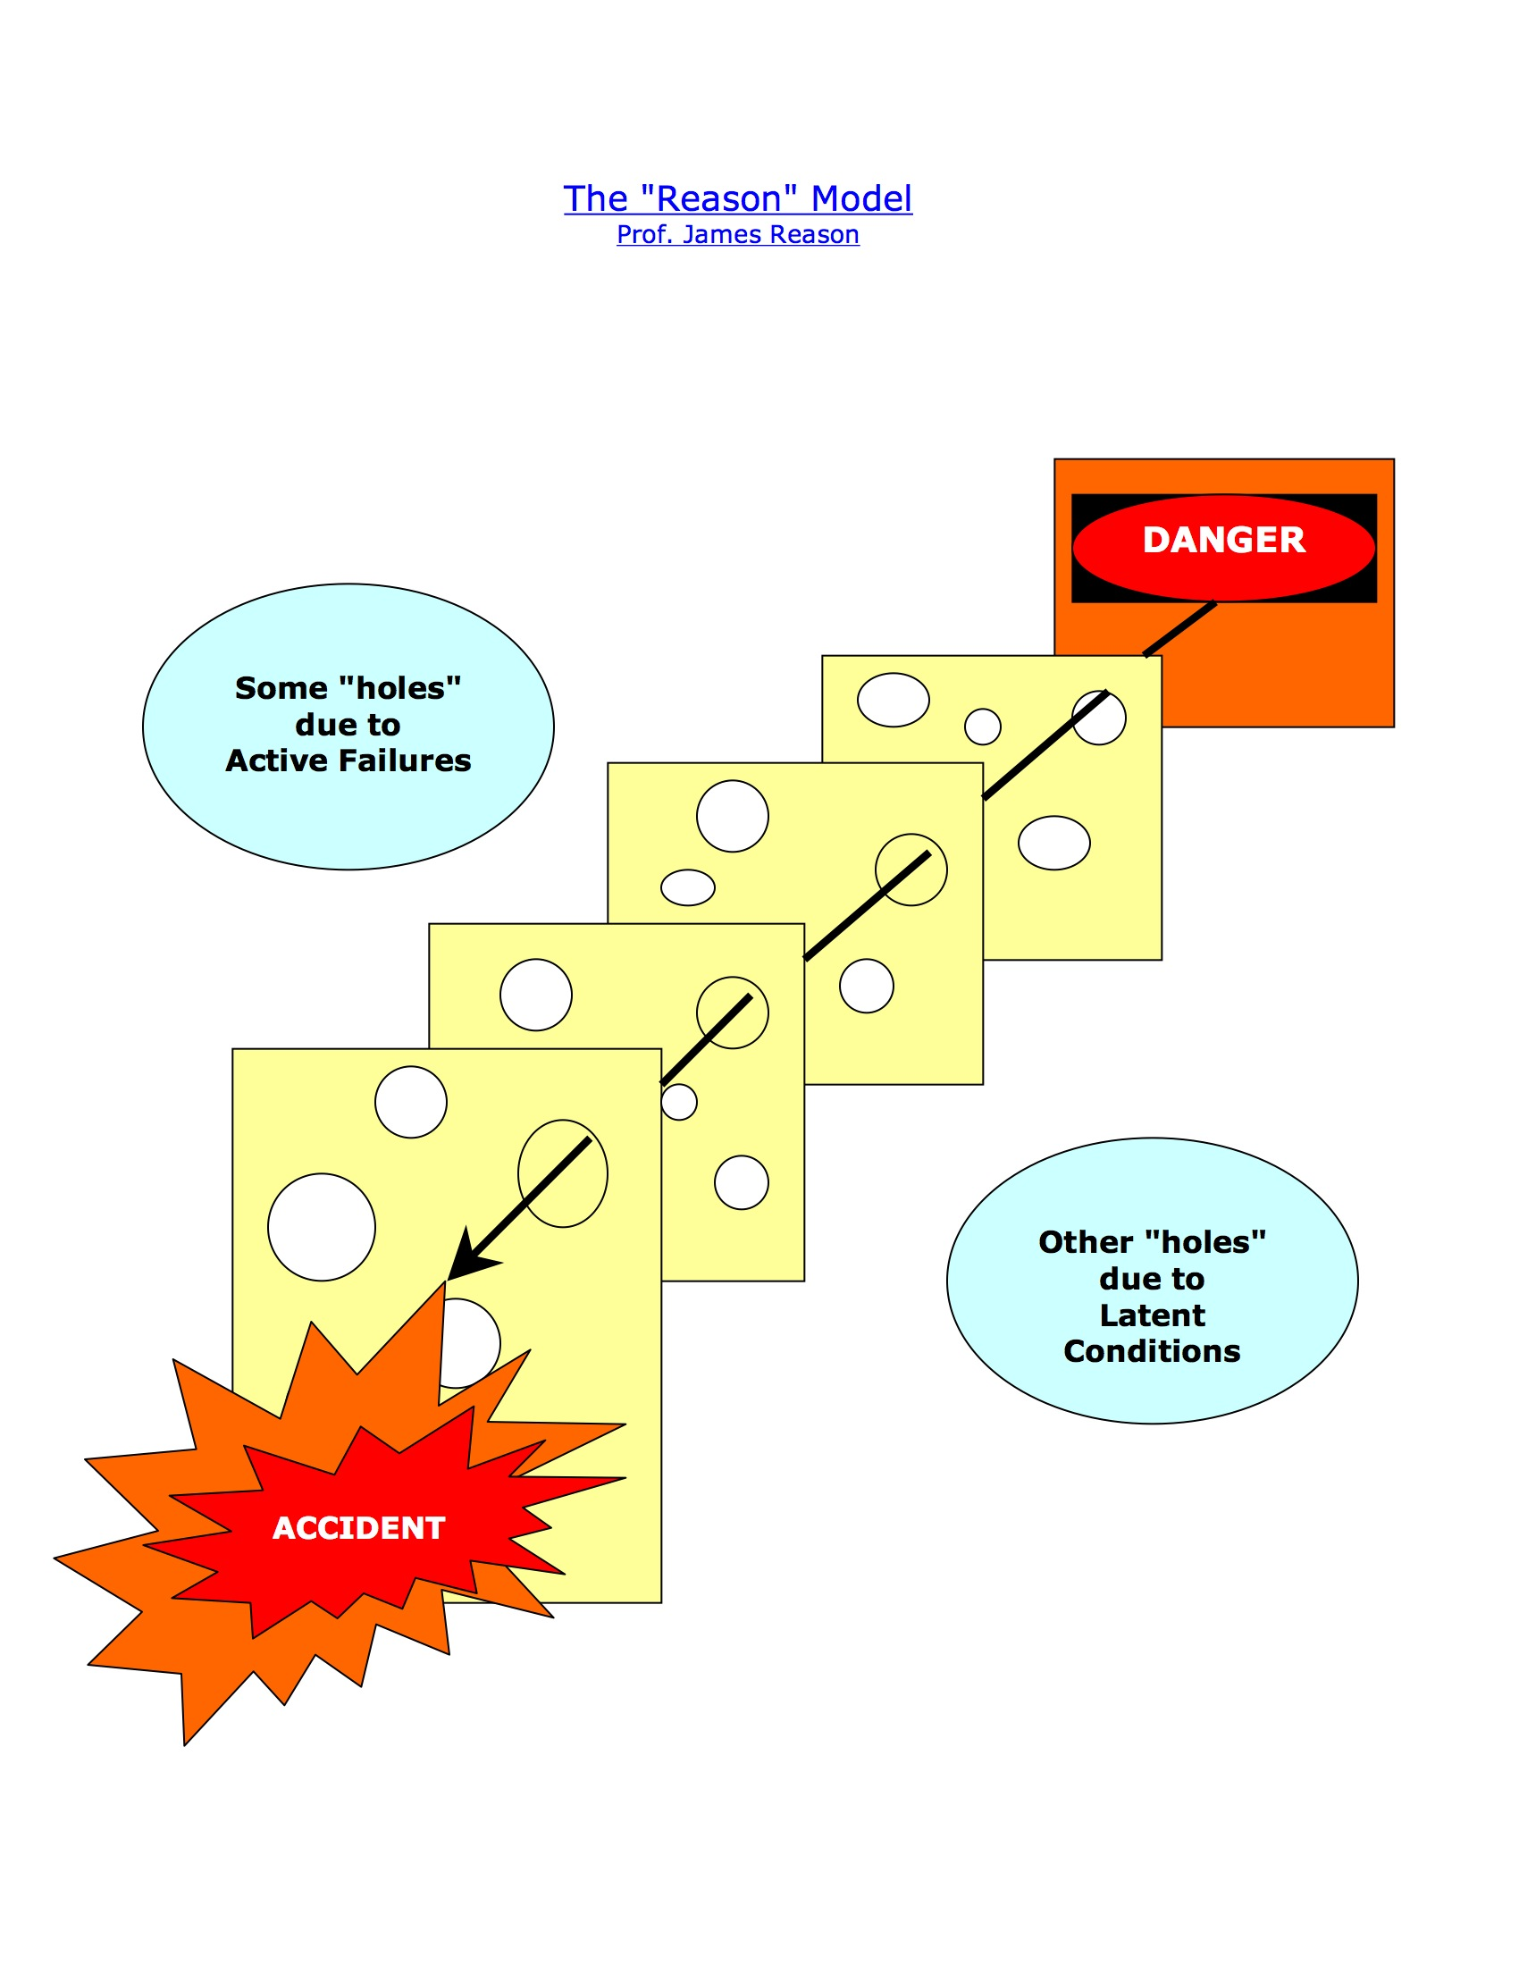

Slide 5
Proactive
Channels
Safety
Information
System
Unsafe Acts
1
Local Workplace Factors
2
Organizational Factors
3
The Candidate Areas for Proactive Process Measurement
Prof. James Reason

Slide 6
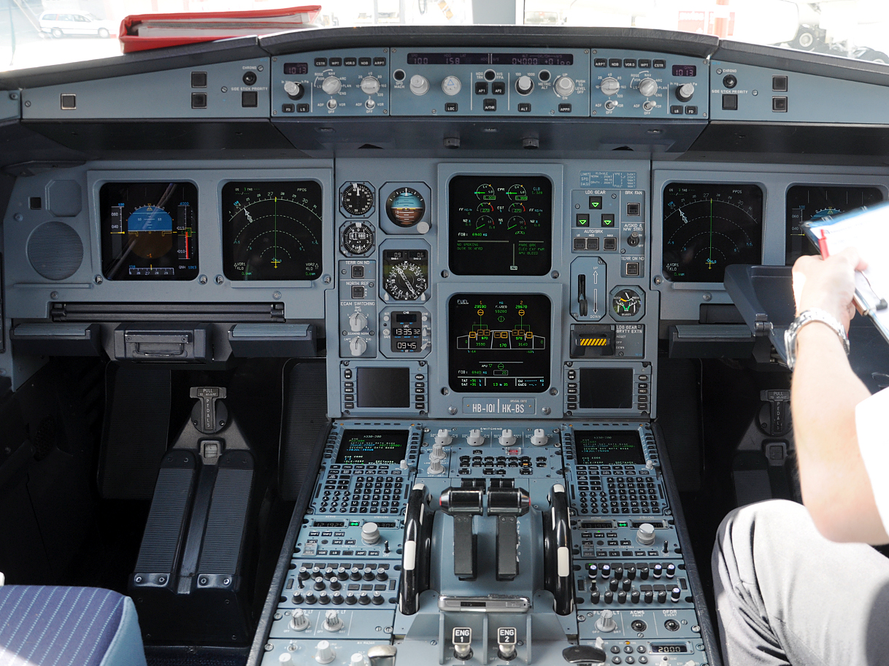
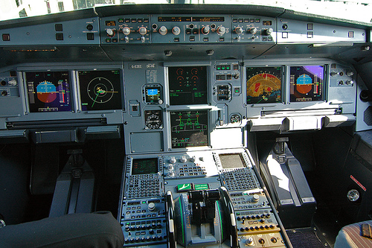
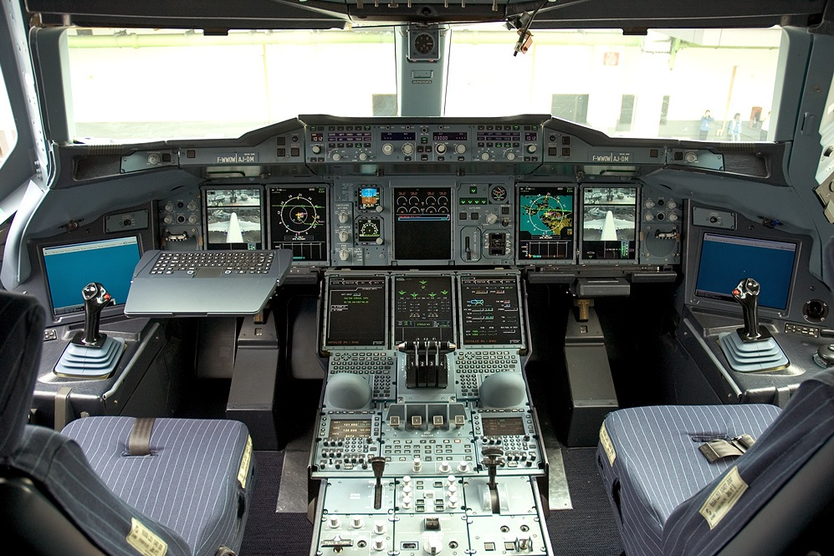
A320
A330
A380

Slide 7
The Philosophy of “Pro-Active Safety Management”
Safety Management = Risk Management
Risk Control : Cost Control
Cost Control : Efficiency
Efficiency = Productivity
Productivity = PROFIT

Slide 8
Thank you
Do you have any questions?
www.assm.biz

