Slide 1
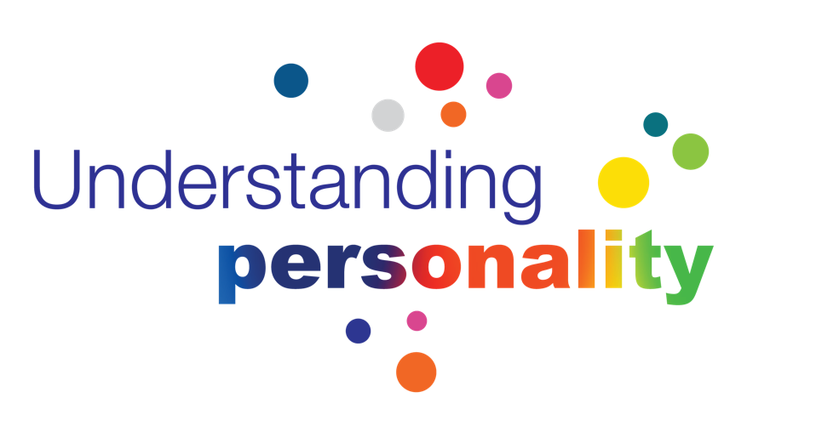

A conversation with InterManager
February 2018
Grant Gemmell
Global Head of Operations

Slide 2
“As psychologists we adhere strongly to scientific principles but as practitioners we know that nothing works unless it is easy to understand and apply. Our mission has been to turn reliable data into information that is presented in the most practical and usable way possible.”
Facet5 is a multi-lingual, global measure of personality, powered by a passion for development.
Norman Buckley
Rebekah Williams
Authors

Slide 3


Facet5 Facts
We have been partnering with organisations for over 27 years across the globe
40+
32
20+
42
We speak over
40 Languages
Available in
32 Languages
Over 20 report types
That cover the spectrum
of individual, team
and organisational
development reporting
4000
42 Norm Groups for
meaningful comparison
42
30
A global network of over 4000 active practitioners
40
27
A growing network
of 30 partners distributing
in over 62 countries
National Character
Research across
42 countries
Developing for
27 Years

Slide 4
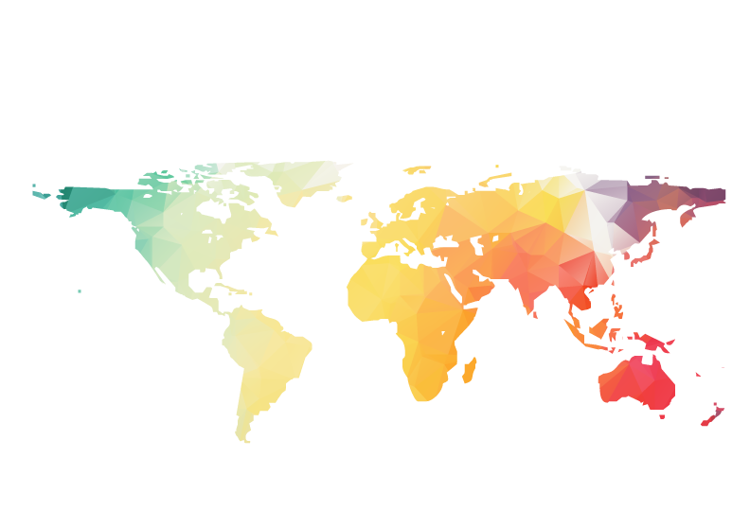
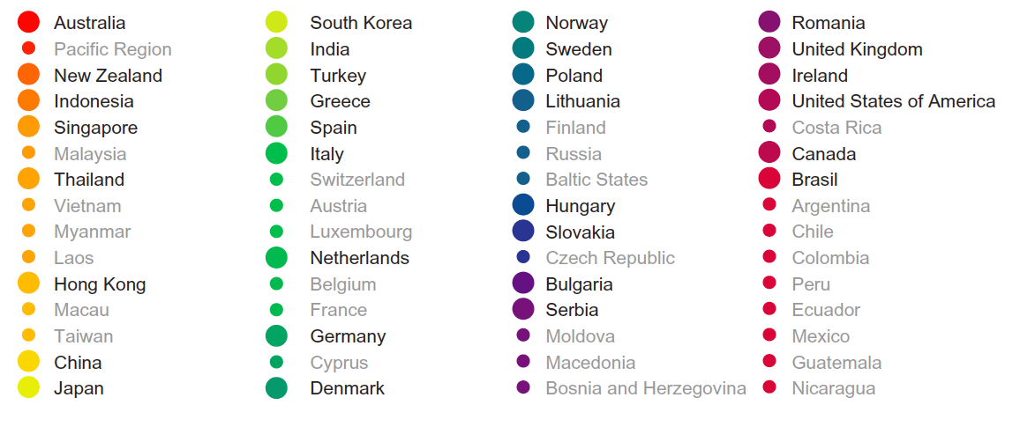
Our Reach
We are a global company with extensive experience and reach

Slide 5
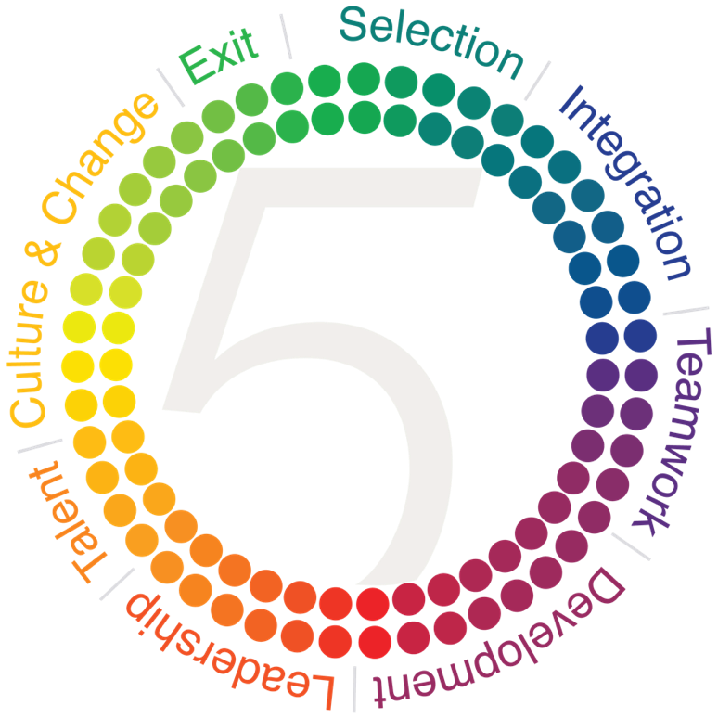
Our Products and Solutions
Our solutions support individuals, teams, leaders and organisations
Encourage advocacy on exit or separation from your organisation. Provide a learning opportunity for both employee and manager
Attract & Select the right talent, by defining the success elements for the role, team and organisation
Integrate them quickly. Increase productivity and return by understanding individual motivators, drivers and work preferences
Develop their ability to manage and lead change. Identify the culture of your organisation and their role in its ongoing transformation to meet market demands
Understand their contribution to the team, and its work. Provide a common language to assist with communication, understanding, feedback and overall team performance
Understand their pathway in your organisation through effective Talent identification & management strategies
Build their capability to lead others and the organisation through understanding their leadership style and development areas
Harness their individual strengths and manage risk areas with focused personal development planning, work preferences and career planning

Slide 6
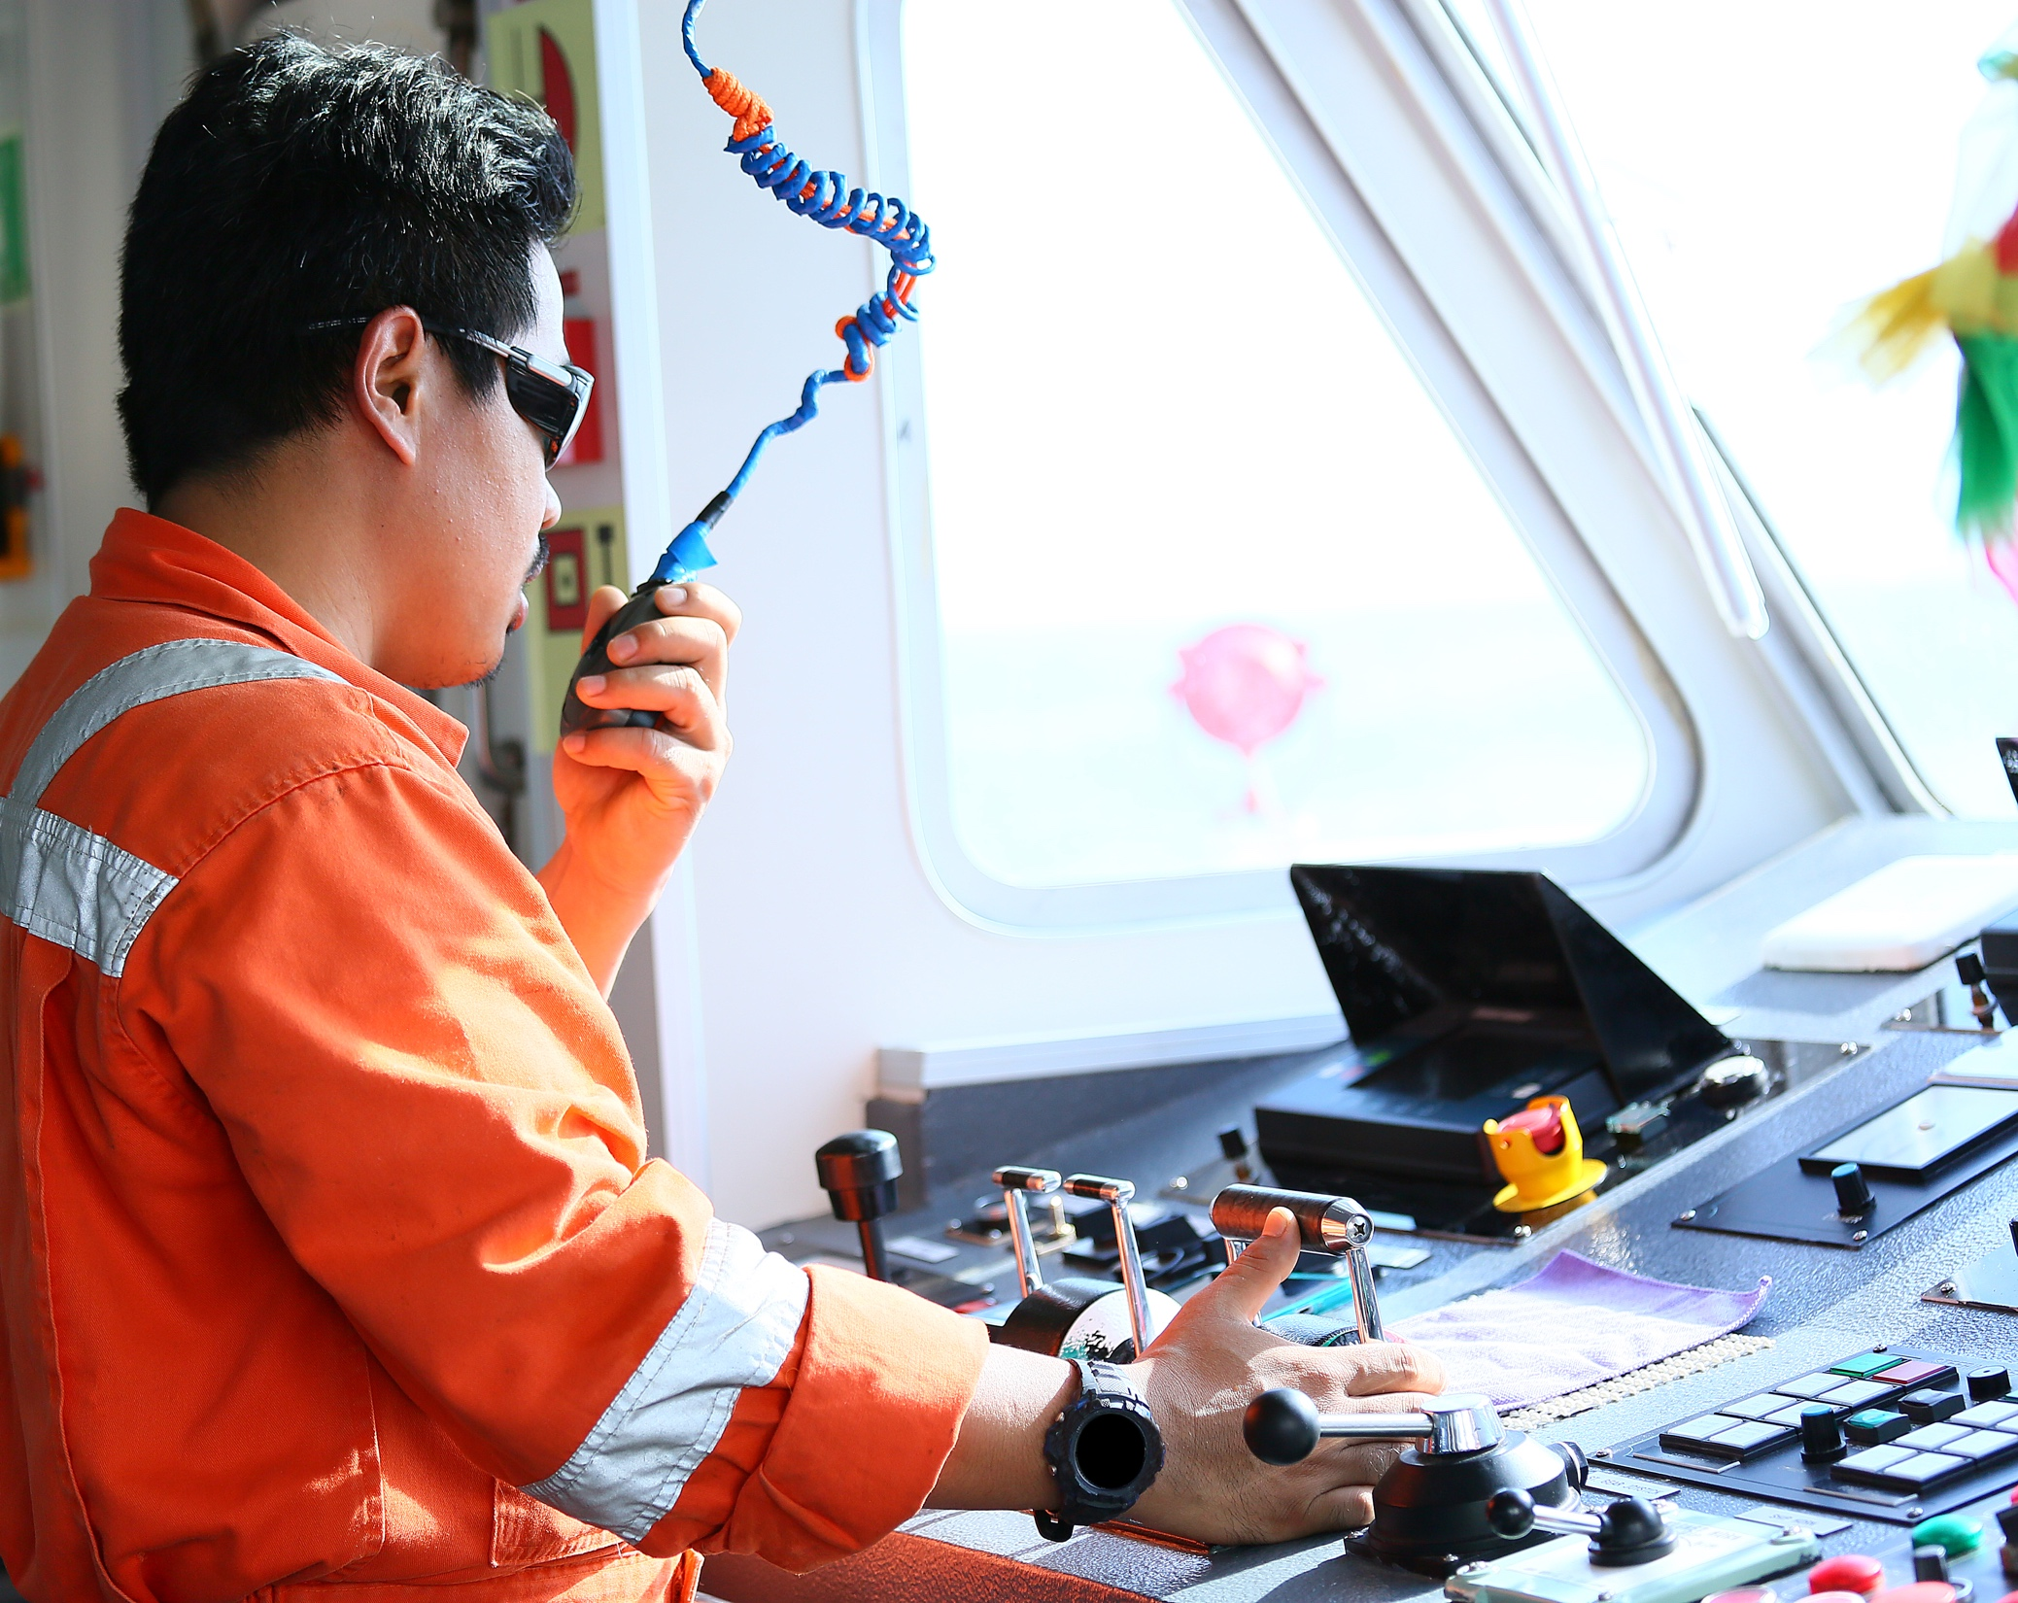




Slide 7
A snapshot of our conversation
Shipping is a global industry which is very large, complex and expanding!
The speed of technological development and advancement across the Shipping industry is increasing
While this is having a positive shift in the overall decline on number of safety related incidents*
Some areas of the globe are struggling to keep pace in people terms – with a potential over reliance on technology
This is driven by Board and Owners demanding more economies of scale in business process and practices, and an
Increase in regulation
This complexity has lead to a ‘tick in the box’ culture for certain aspects of the business – particularly around people practices
*AGCS Safety Shipping Review 2017

Slide 8
People Practices
Shipping is a global industry which is very large, complex and expanding!
The cyclical nature of shipping has lead, historically, to ‘short termism’ in the development of people – with a stronger focus on technical training vs soft skills training
These soft skills include:
  Feedback & recognition
  Trust
  Respect and understanding of diversity
  Collaboration & Innovation
  Conflict management
  Personal accountability
  Personal awareness and emotional awareness
  Leadership
And importantly developing and maintaining a strong ‘Safety Culture’

Slide 9
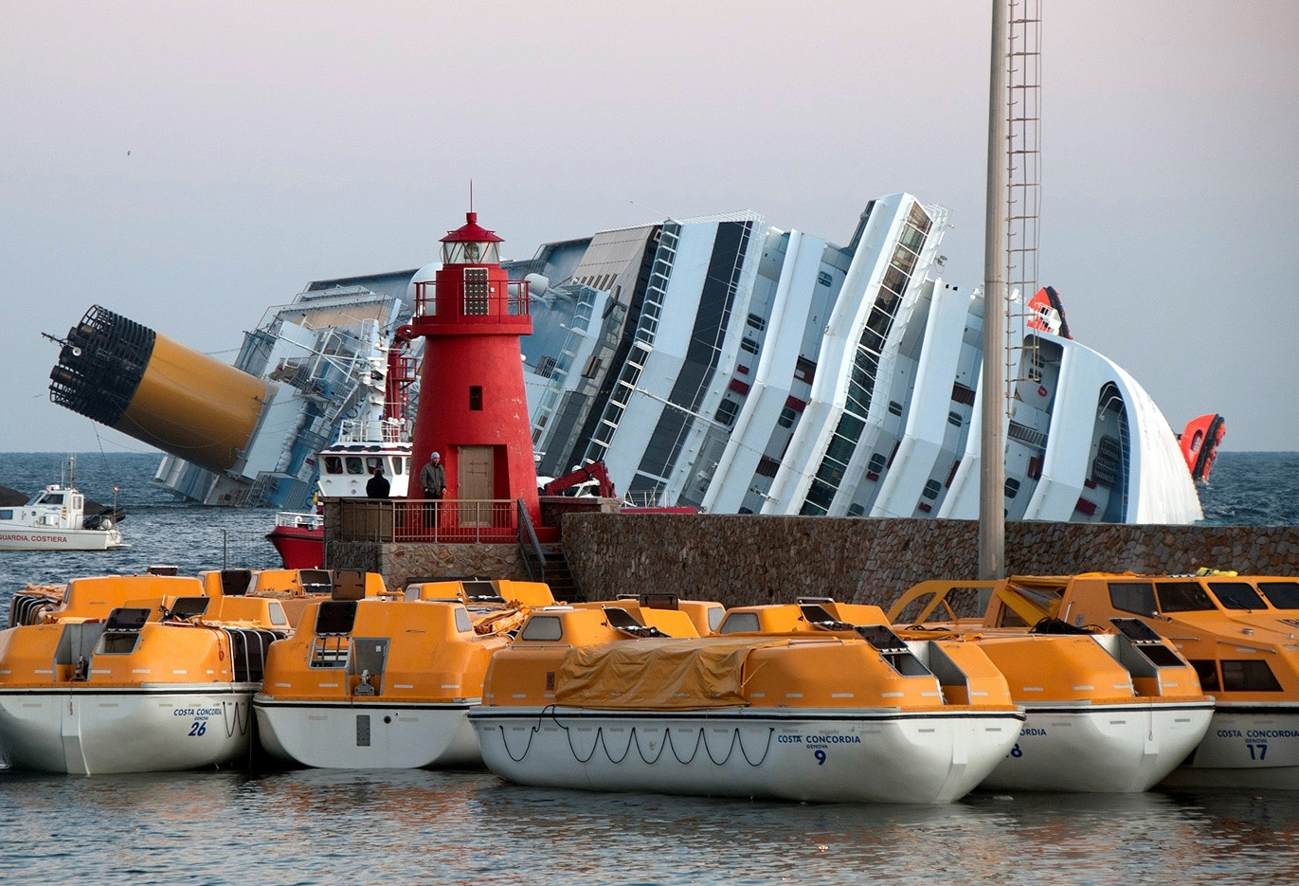
75%
Human error has long been regarded as contributing to the majority of incidents in the shipping sector. It is estimated that 75% to 96% of marine accidents can be attributed to human error
AGCS Safety Shipping Review 2017

Slide 10
The role of Personality Assessment
Personality assessment is one component of a multi part strategy
Organisational Performance
Employee Engagement
Employee wellbeing
Collaboration & Innovation
Risk & Safety
Excellence
Trust & Commitment
Core competence (Crew, Engineers, Captains)
Understanding Self
Interpersonal & Influencing
Decision Making
Personal resilience
Diversity & Inclusion
Approach to risk & safety
Organisational Values and Culture

Slide 11
Where does personality assessment add value
Supporting individuals, teams and organisations to realise their potential
Work with organisations to understand their culture – strengths and risks
Supporting the definition of ‘Top Performer’ profiles (both current and future state)
Support effective recruitment and selection
Enable individuals to realise their potential through intrinsic understanding of self and targeted development
Enable leaders to understand their leadership style and how to lead more effectively

