Slide 1
Role of Ships Agents InterManager AGM Singapore 4th October 2016 Frank Olsen

Slide 2
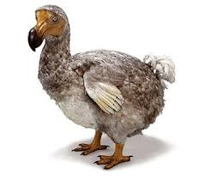
Avoiding the fate of “The Dodo”
MV DODO Ex.LENA T.-94,MUPO-93,CHRYSANTHEMUM-83
Scrapped Alang 2001 Gt. 7 845 Nt. 4 746 Deadw. 11 810t. Build 1974 Shikoku Dockyard Co.Ltd Takamatsu (777)
Photographer: Capt. Jan Melchers
The dodo (Raphus cucullatus) is an extinct flightless bird, has historically been considered fat and clumsy.
The bird was hunted by sailors and invasive species, while its habitat was being destroyed

Slide 3
The expectation

Slide 4
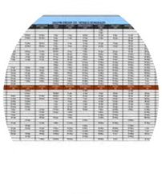
Leveraging Technology
Make relevant information available in an easily accessible manner “real time”
Benchmark and report; Industry peers and historic data
Transparency fosters trust
Demonstrate Savings, Efficiencies and Value
Innovate to solve problems

Slide 5
Crew logistics
Real time “Duty of Care” visibility
Effective disruption management
Multi service booking ability
Cost management
Document and visa coordination
Technology is a key enabler and a true game changer in how crew travel is planned, performed and managed

Slide 6
All about the CASH
The 3 global ship agency companies delivers a total of approx. 270 MUSD in Cash to Master Annually
Cash is King, but it is also:
Expensive
Risky
Enabler for unethical behavior
Administrative burden

Slide 7
In conclusion
Providing customers with new perspectives helping to drive their business forward.
Service
Delivering consistently high standards so our customers can always rely on us
Savings
Reducing our customers' costs through scale and innovation
Insight
Combining the best of traditional agency work, meaningful use of new technology and close collaboration with the principal

Slide 8
Thank you

