Slide 1
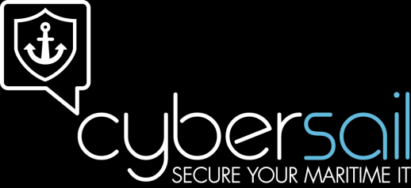
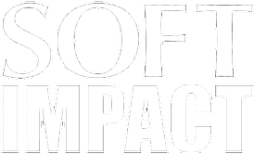
Maritime Cyber Security – The human aspect
Markus Schmitz
Managing Director
SOFTimpact Ltd.

Slide 2
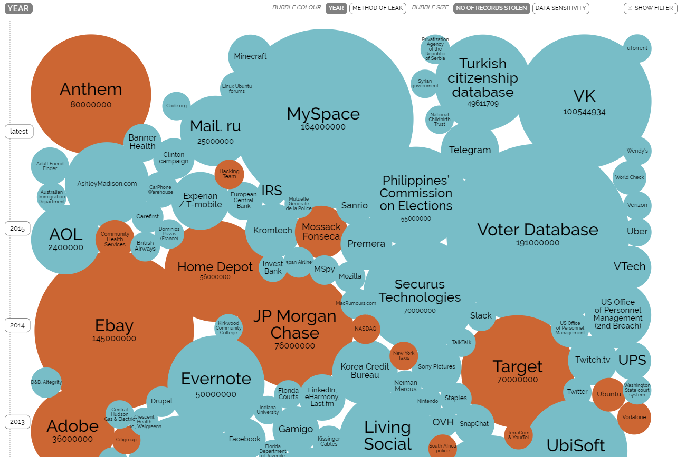
Hacks this year
Source: http://www.informationisbeautiful.net/visualizations/worlds-biggest-data-breaches-hacks/
Markus.Schmitz@soft-impact.com
2

Slide 3
Fact or fiction
Is the
Maritime Industry
under
cyber attack?
Markus.Schmitz@soft-impact.com
3

Slide 4
Allianz 2015 Maritime Risk Report
“The sector is increasingly vulnerable to
a major (cyber) attack”
smaller crews on-board
larger ships
growing dependency on automation
Markus.Schmitz@soft-impact.com
4

Slide 5
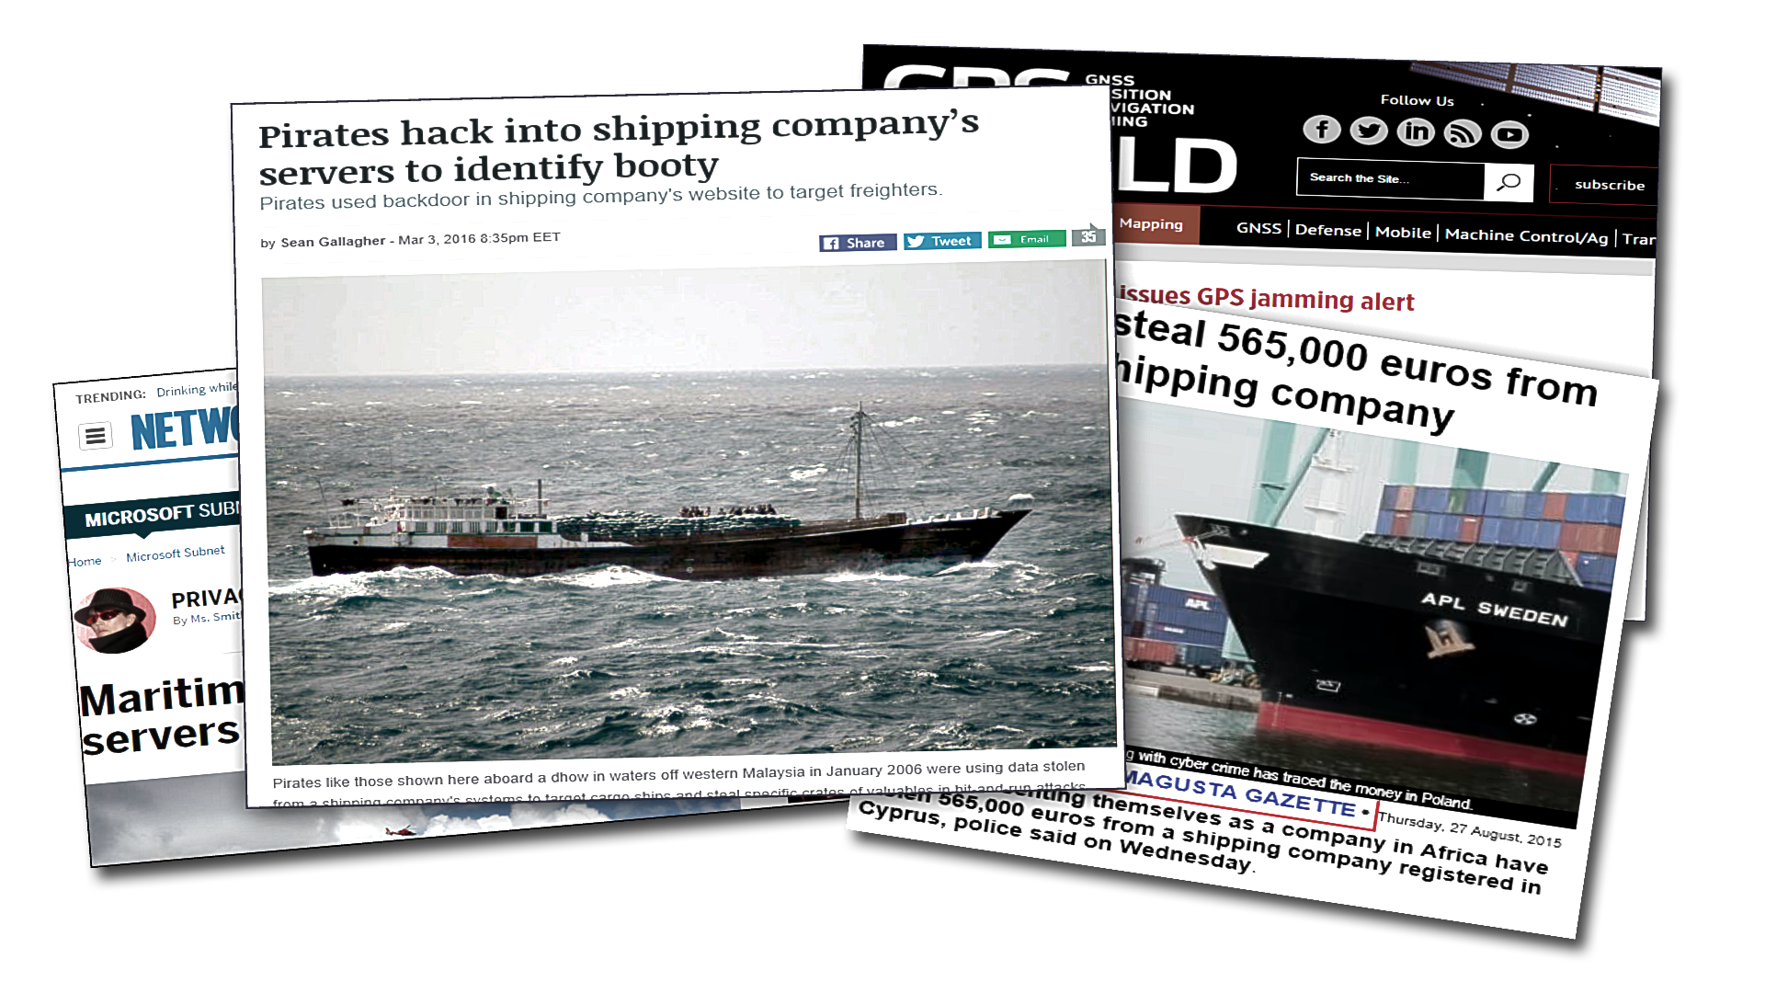

In the news…
Markus.Schmitz@soft-impact.com

Slide 6
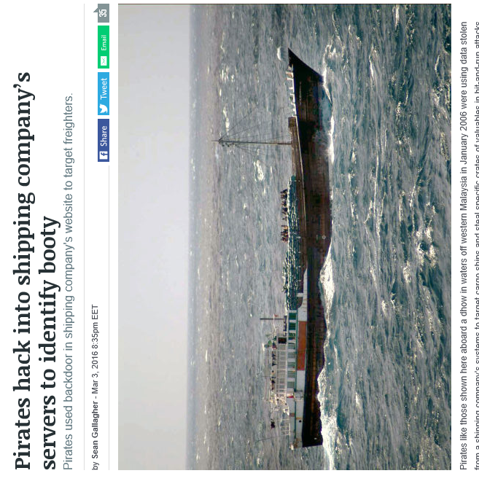
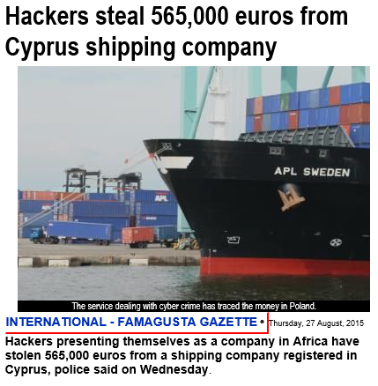
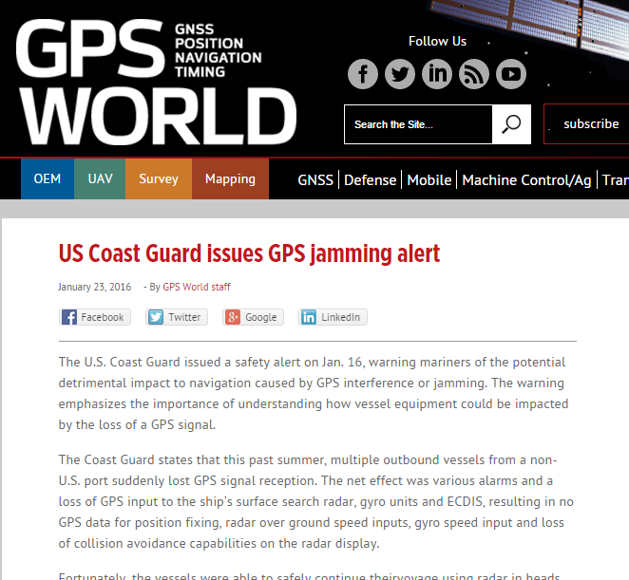
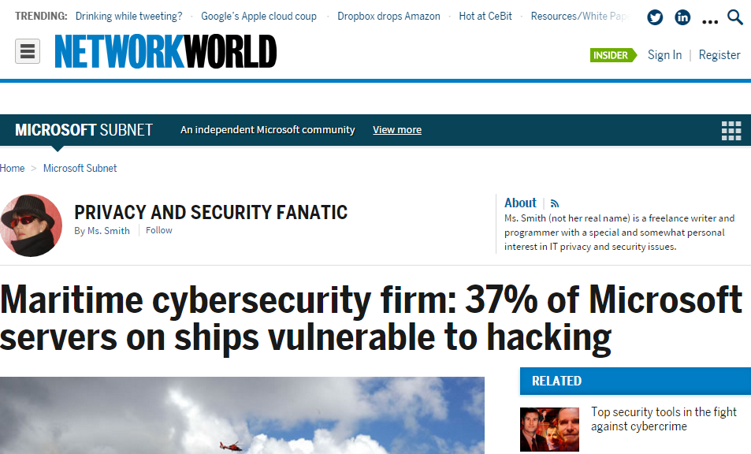
In reality…
Markus.Schmitz@soft-impact.com

Slide 7



Where are we today?
Yesterday
Today
Tomorrow
Markus.Schmitz@soft-impact.com
Notes:
Now is the time to prepare for the future

Slide 8
But …
“Hackability” of ship systems is proven
The Maritime industry is an interesting target
  Large monetary transfers the norm
  Multiple parties involved in transactions
  Different time zones for financial institutions
Insecure systems
  No longer hidden from the world
  Faster connections for attack
Markus.Schmitz@soft-impact.com

Slide 9
If technology is the problem, …
  is
  technology
  the
  solution?
Markus.Schmitz@soft-impact.com

Slide 10
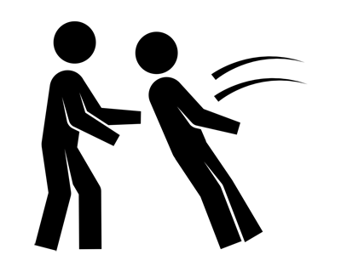
The human aspect
Humans trust humans
Humans trust computers
Computers trust humans
Markus.Schmitz@soft-impact.com

Slide 11
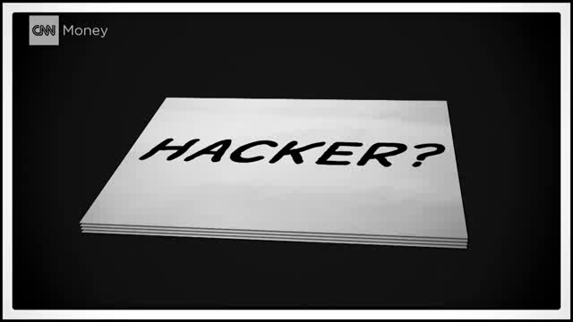
Humans trust humans
Source: https://www.youtube.com/watch?v=e-ZcomTYc64
Markus.Schmitz@soft-impact.com

Slide 12

Humans trust computers
A small questionnaire …
  Do you have a WIFI at home?
  Do your kids use the WIFI?
  Do you give your guests access also?
  Did you use ever the WIFI at airports?
  Did you use ever the WIFI at restaurants?
  Did you use the WIFI in the last hotel you stayed?
  Did you use ever the WIFI at Starbucks?
Markus.Schmitz@soft-impact.com

Slide 13
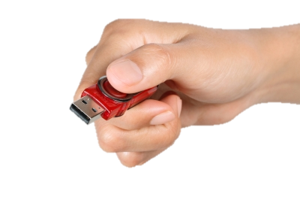
Computers trust humans
Do you
plug?
Markus.Schmitz@soft-impact.com

Slide 14

Key learning
Convenient
(but not secure)
Secure
(but not convenient)
The most important lesson today!
Markus.Schmitz@soft-impact.com
14

Slide 15
Recommendations
Implement security technology!
But do not stop there …
  Raise the awareness of staff & crew
  Review processes
  Trade security with convenience consciously
  Establish a Cyber Security Culture
  Share your experience
Markus.Schmitz@soft-impact.com
15

Slide 16
Questions & answers
www.cybersail.org
Markus.Schmitz@soft-impact.com

Slide 17
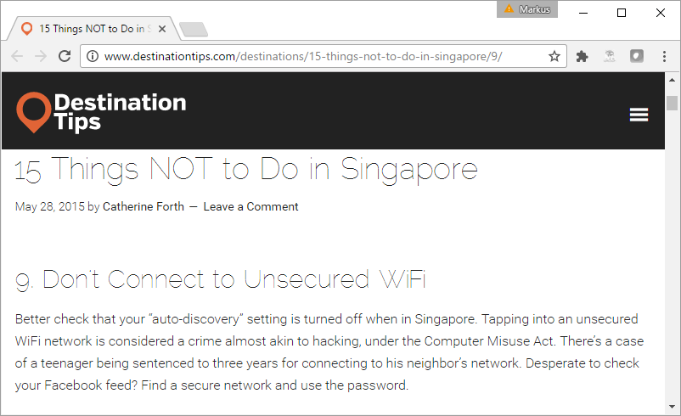
Humans trust computers
This is not the main problem!
Markus.Schmitz@soft-impact.com

