Slide 1
Cryptocurrency for shipping
By Aleks Nowak, CIO @ BlockEx

Slide 2


A little about me
Aleks Nowak
Chief Information Officer at BlockEx
Former British Army Officer, last posted to 17 Port & Maritime Regt Transitioned to commercial maritime security in 2009
Turned Technologist and became involved with Blockchain in 2011
Since then have consulted to UK Govt and Tier 1 institutions outside of my own blockchain projects, which have included:
Cryptocurrencies
Mining
Payment systems
Exchange platforms

Slide 3
Blockchain
“The next big thing” - The Economist
“A wild card that could completely overhaul financial services” - Business Insider

Slide 4
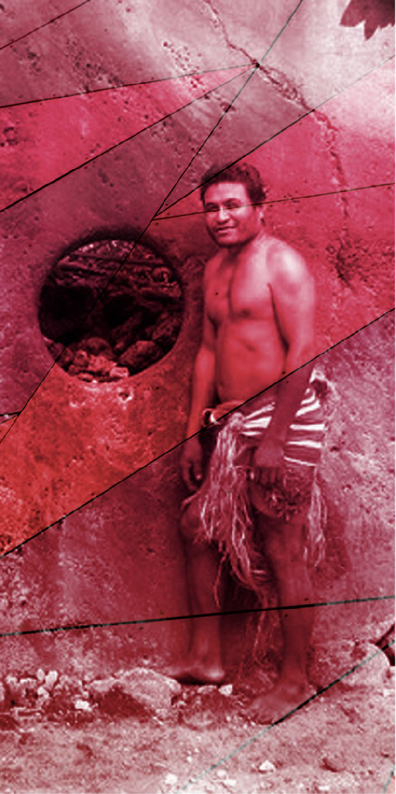
History of Blockchain
To describe the history of blockchain we need to look back 600 years to ISLAND of YAP in MICRONESIA. The islands of Micronesia are the definition of heaven on earth. The climate is tropical and the food is easy to collect from the coconuts and the generous sea. However, they have no precious metals nor limestone. 600 years ago an expedition of Yapese fishermen landed accidentally 250 miles away in one
of the islands of Palau and saw the limestone where spellbound by it. They decided to take a sample to Yap carved in the form of a whale. That is why they called it RAI, which means WHALE in their native language. Later the stones ended up having
a circular shape, which is more convenient. Limestone being a rare commodity in Yap, the RAI soon became currency, following a similar process that gold had in the Mediterranean cultures of antiquity.
At first the rai stones were small, but over time the stones grew in size. Some are huge and weigh four tons. The labor needed for the extraction and carving of the stones was very significant, since they did not have iron tools, they only used shells and corals.

Slide 5
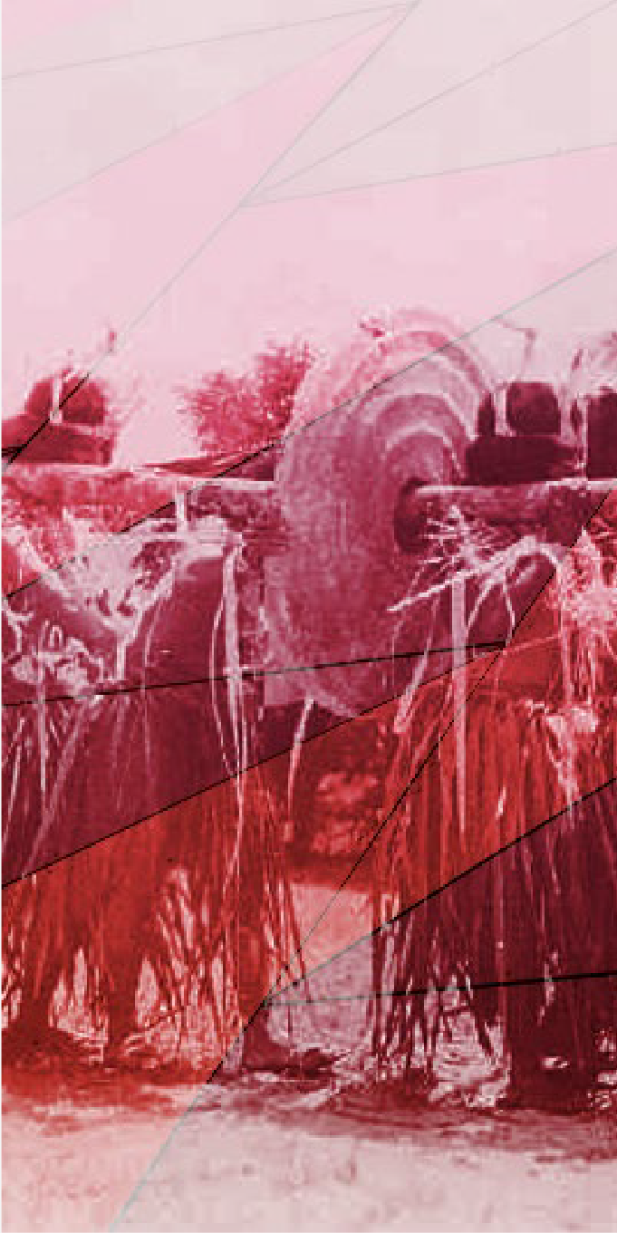
History of Blockchain
Transportation was also an issue. Many men were needed to move the heavy stones. All rais have the center cut up to cross a trunk so that it can be lifted by several men. Another difficulty was the shipping across the sea, since the Yapese had only light canoes and rafts. Many men died in the process of manufacturing rais. (The more
dead the more the rai was worth)
Being difficult to dig, carve and transport, the stones had a great value. The larger the rai, the more value it had, but the story behind it was more important than the size. IF a rai that had cost the death of ten Yapese was more valued than a rai that had no blood stains. The stones had no functionality, nor had any spiritual or religious value. They did not even have ornamental value, however they soon began to be used as money. The intrinsic value of rais resided only in the effort it had
taken to get them.

Slide 6
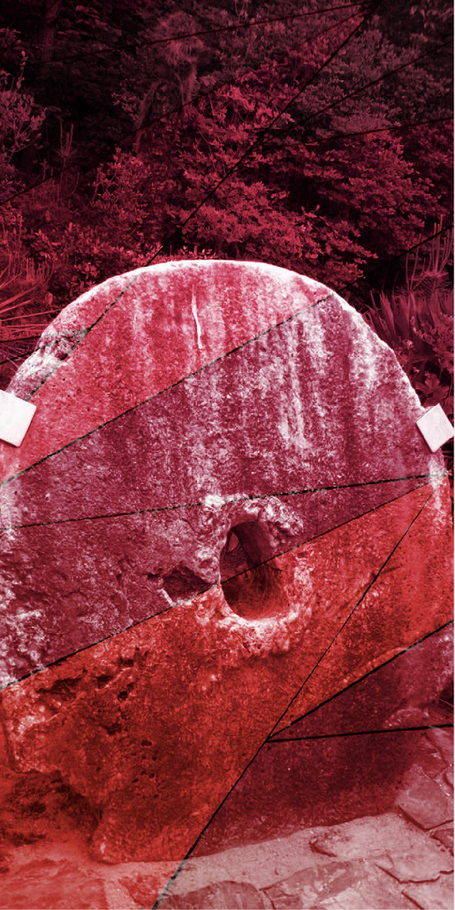
History of Blockchain
Importing the Stones
Even the possession of the stones had no meaning.
The relocation of the stones was very complicated and risky because if the stone wheel broke, it lost all its value. To make a payment, the payer communicated
the transfer of ownership of the rai publicly, without moving the stone. Usually the chief of the village served as the notary, only the person who was publicly recognized by the community could be considered the owner of the rai.
Most interesting of all is that there is a very rich family in Yap whose rais nobody has seen in more than a century, but they have value nonetheless.

Slide 7

History of Blockchain
Story of the rich family without the stones. As the story goes, there was an expedition that carved a huge rai, the value was immense. On the way home to Yap a storm shook the canoe and they lost the raft with the enormous stone attached to the canoe, which ended up sunk into the sea. The survivors of the tempest explained their adventure and the entire island decided to accept the lost rai as payment, although it was in the bottom of the sea. The interesting thing is that no one has seen that money in 150 years and it is still used as currency and it is accepted in the public
ledger of rais.
This concept is essential to understanding blockchain:
And in is one of the first examples of a public a simple ledger. in the effort it had taken to get them.

Slide 8
The stones had
no non-monetary Value
It was impossible to do a trade in secret
Some Interesting
Observations
Eventually spending your stones didn’t require physically moving the stone – just acknowlegement of a change of ownership
They developed a form of distributed ledger, but it couldn’t scale...

Slide 9
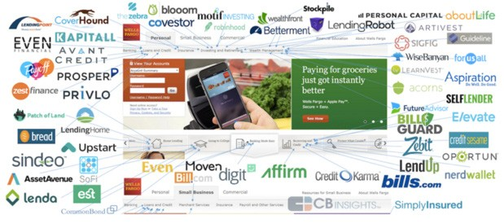
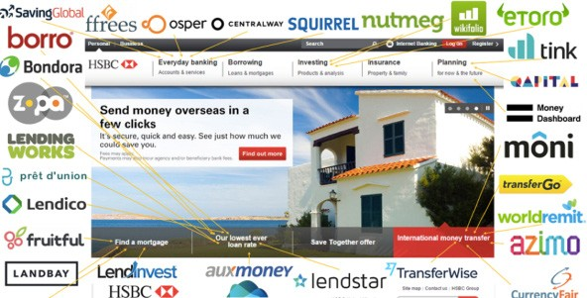
U.S
In the mid-2000’s FinTech
“Unbundling Banking”
Initially, these startups are small & look harmless, therefore are ignored.
The banks wasn’t scared of FinTech initially, because they don’t believe technology can overthrow their silos
E.U

Slide 10
The Birth of Crypto- currencies & Blockchain
Cryptocurrencies
Blockchain
Bitcoin was the first ever cryptocurrency concept (since 2008)
Underlying Technology for
Bitcoin
Tamper proof Distributed Ledger Technology that has the most potential to radically change how business is done since the advent of the Internet
Decentralized Currency that is not controlled by any central bank.
Clearance & Settlement
(through PoW or PoS)

Slide 11

What is Bitcoin?
Bitcoin is a cryptocurrency,
created and held electronically by a network of computers
Satoshi Nakamoto proposed bitcoin, which is an electronic payment system based on mathematical proof.
What are its characteristics?
Decentralized
Pseudo-anonymous
Transparent
Open source with no barrier to entry

Slide 12

What is Blockchain?
Blockchain Core Technology
Technologies Involved: Cryptography Distributed Ledgers Consensus Algorithm Smart Contracts
Peer to peer networks
Can enable:
Wider direct partipation
Lower Costs Efficiency
Trust-less systems

Slide 13
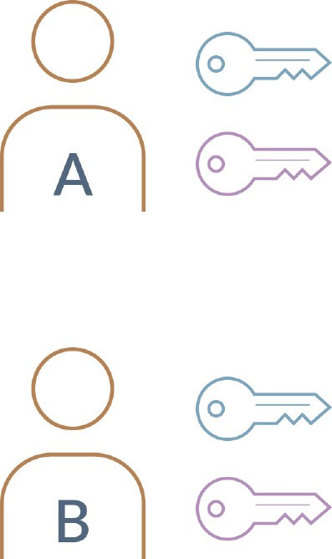
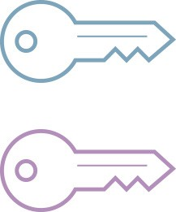
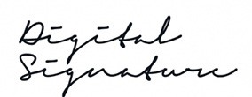
Cryptography
Each of them holds a private key and a public key
The combination of these keys can be seen as a dexterous form of consent, creating an extremely
A’s Public Key
A’s Private Key
useful digital signature
Public Key
Private Key
+
B’s Public Key
B’s Private Key
Digital Signature

Slide 14
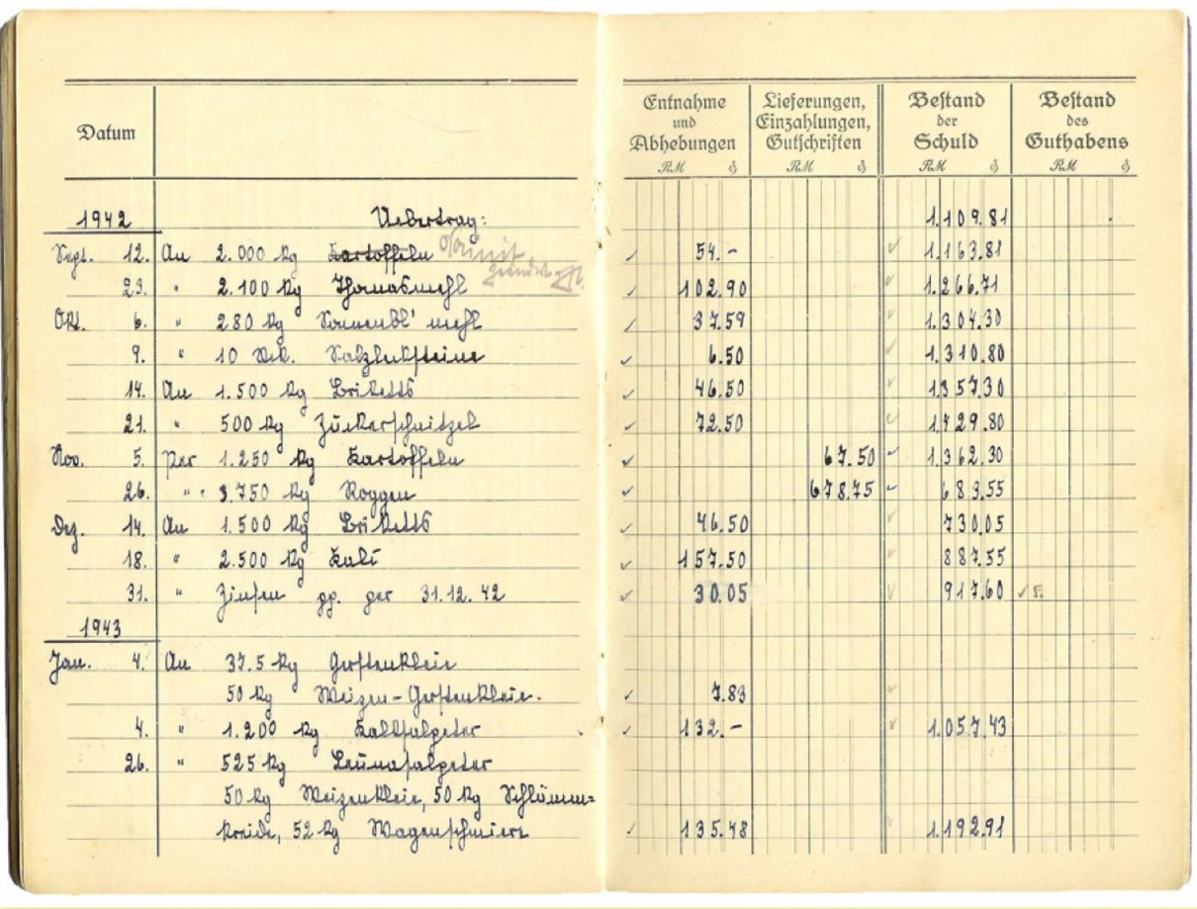
Distrubuted Ledgers
Secured by computing power in a distributed network
Data distributed across multiple nodes to store entire history
Provide security and resilience against attacks on central network and hardware equipment by removing any single point of failure

Slide 15
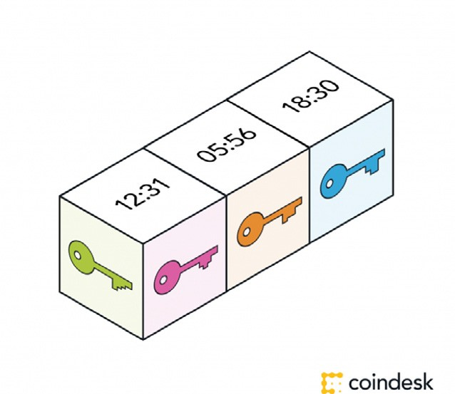
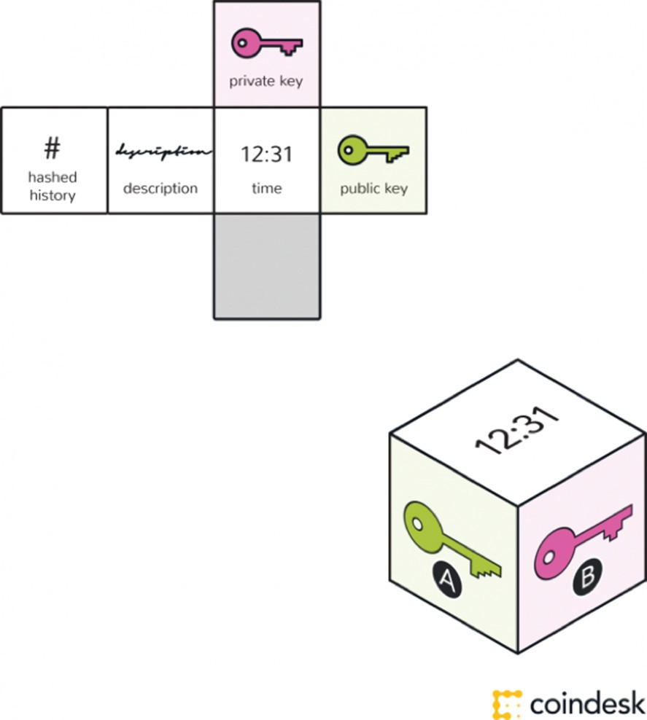
Blockchain
This block is timestamped, and can also contain data or messages.

Slide 16
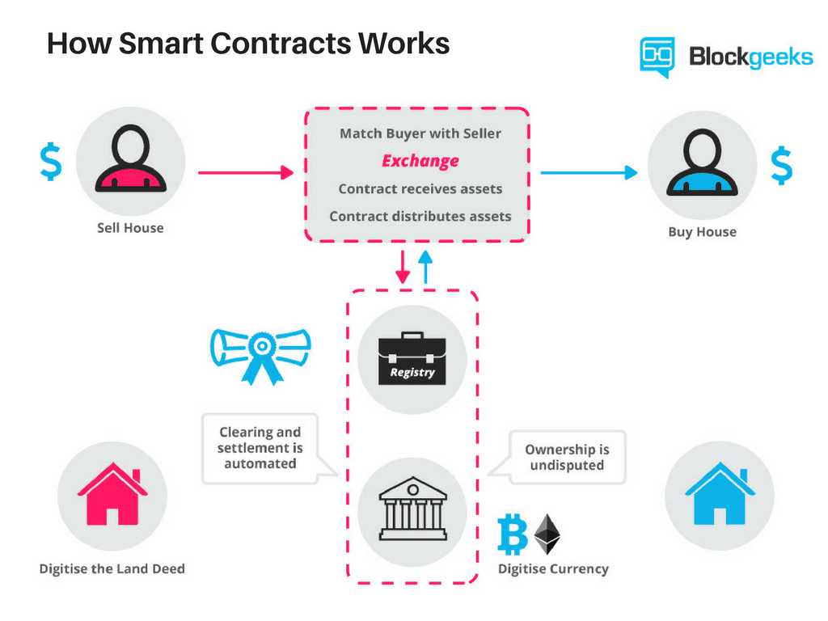
Smart Contracts

Slide 17
Considerations within shipping

Slide 18
Potential Use Cases
Payment & Collections
Key Benefits
Reduce cost and increase speed for payments
No risk of held or lost international transactions
Reduction of counterparty risk
Lowers or negates the requirement for credit arrangements
Increases transparency of payments
Using blockchain as payment infrastructure (especially across multiple countries)
Payment automation may be enabled by the automatic evalutation of payment conditions by smart contracts

Slide 19

Potential Use Cases
Supply Chain
Key Benefits
Reduce cost of operations, suggested minimum of 20% saving in costs
Single source of truth, reducing duplication and human error
Permission participants to access reliable relevant information to their role
Permanent and detailed audit trail
Reduce fraud
Fully automate many processes via event driven smart contracts
Use blockchain as a reliable single source of truth for all information pertaining to each transaction
Securely digitise and automate the management and filing of all associated paperwork

Slide 20

Potential Use Cases
Insurance
Leverage blockchain for information about insured
objects and events in order to fight fraud
Automate claims triggering and handling with smart contracts, and e.g., with sensors (IOT)
Key Benefits
Reduce average costs to insurer due to increased efficiency in
  Claims administration
  Damages from fraud and fraud detection
Improve identification of claim events and therefore expedite claim processing
Potential reduction in premiums thanks to lower
fraud

Slide 21
What does
Distribution
Asset Creation Tool
BlockEx offer?
ICO
November 2017
Asset Servicing
Bond
June 2018
FIX
Ready
Syndicated
Loans
March 2018
Exchange
Custodianship
Brokerage Software
Ready
Automated
Golden Gate
February 2018
Corporate Actions
Trading Terminal January 2018
Trade Finance
March 2018
Equities
September 2018

Slide 22



Email: aleks@BlockEx.com
Company Info: BlockEx.com
ICO Info Site: DAXT.IO

