Slide 1
Big Challenges, Big Opportunities
Mikael Weis, Chief Operating Officer, ShipServ
InterManager’s One-Day Ship Management Forum
5 February 2018

Slide 2
Agenda
A very quick corporate intro
Spend analytics project
Benchmarking and supplier performance – new reports
Consortia
Questions

Slide 3
ShipServ’s Mission
Our mission is to drive transformation of the maritime supply chain through digitisation, data insights, efficiencies and communications improvement

Slide 4
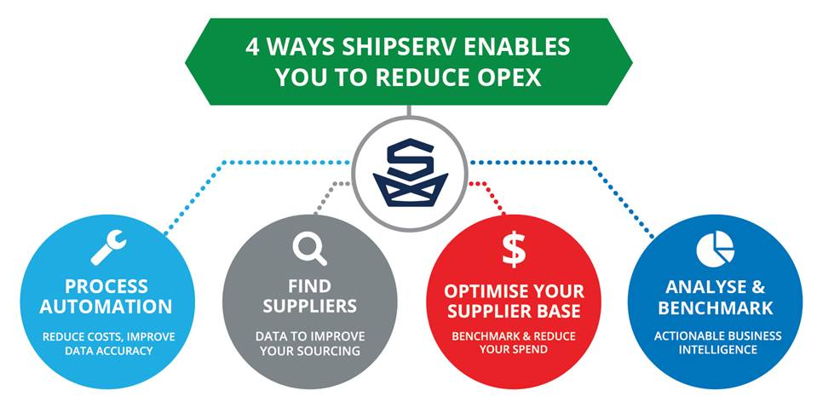
What we actually do…

Slide 5
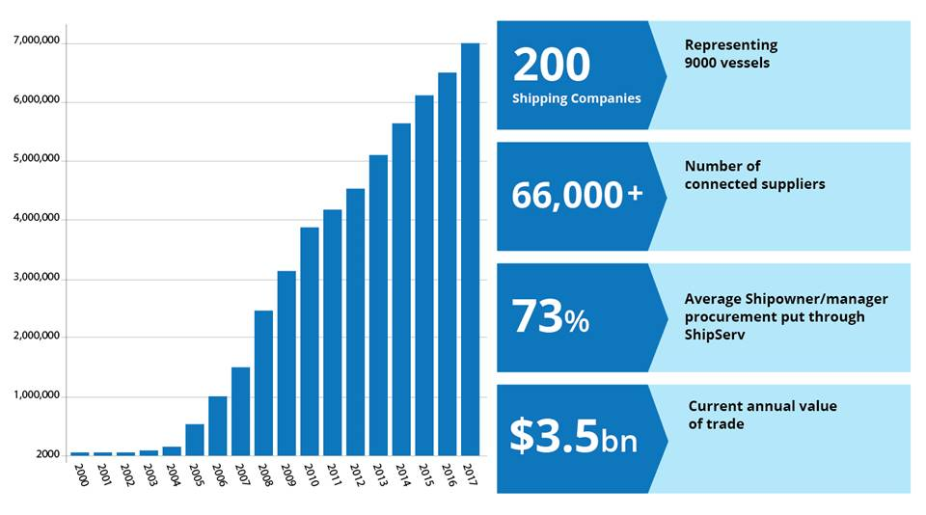
The world’s largest marine procurement platform
We successfully deliver millions of transactions every year

Slide 6
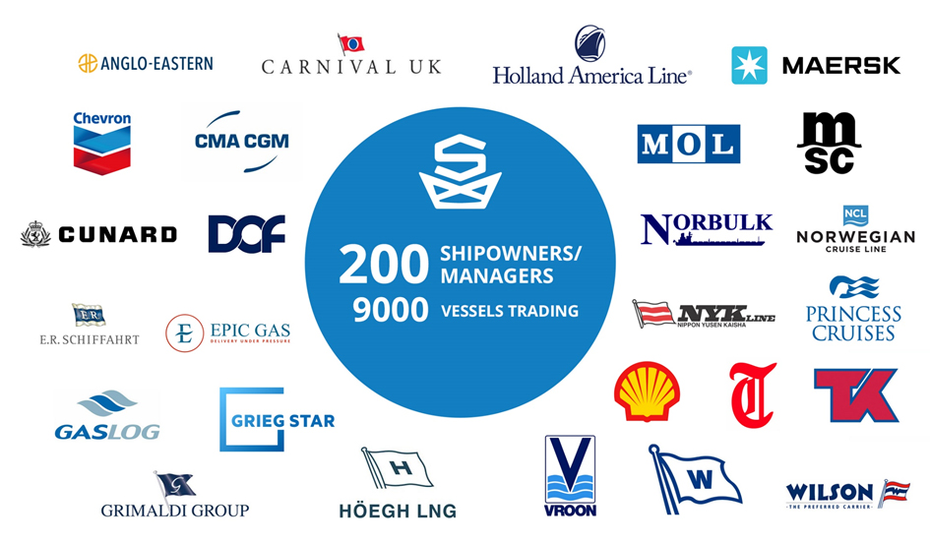
Some of our key buyer customers…

Slide 7
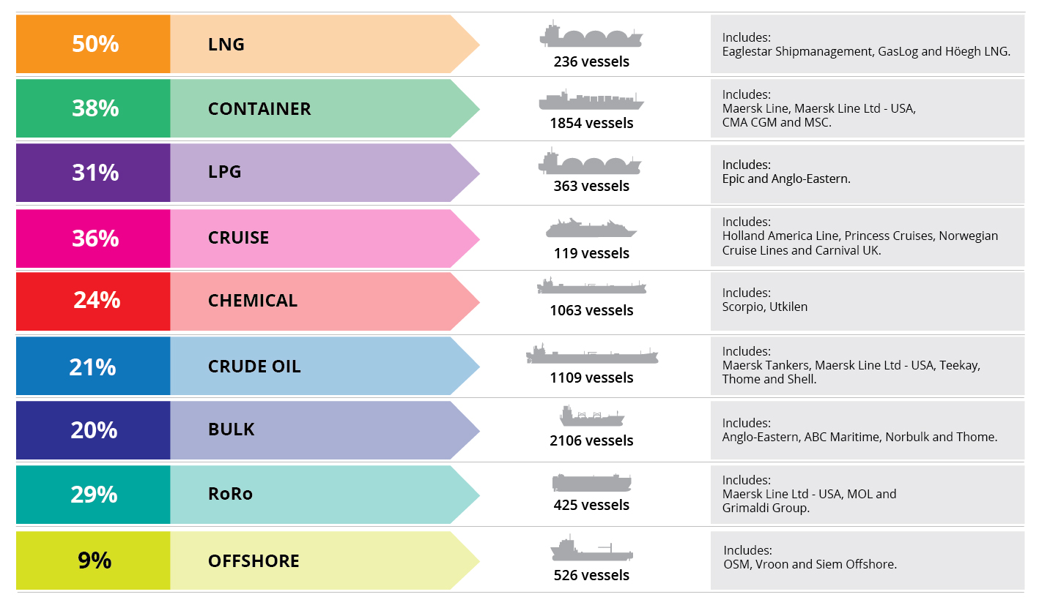
Penetration in key sectors
Selected vessel sectors only
Includes vessels under third party management
Source: IHS Fairplay Fleet data 2018 where there is a known technical manager, and vessels under 40 years old, and the vessel is over 200 GT for work, over 100 GT for cargo

Slide 8
ISO 27001 Certified
GDPR compliance in May 2018

Slide 9
Buyer Survey

Slide 10
How difficult is it for you to answer spend questions?
How much are we spending on any category, sub-category, brand or product?
What products are we buying and how frequently are we buying them?
What brands or product/service are we buying from each supplier?
Where are we delivering our orders?
What equipment, brands and products does each vessel or office purchase for?

Slide 11
How difficult is it for you to answer spend questions?

Slide 12
Is the ability to answer such questions something you need or don’t need?

Slide 13
Make smarter buying decisions
From the survey here were the strong requirements:
Resolve the dirty data issues
Increase spend under contract and track adherence
Benchmark
Accurately report savings by category
Monitor quality
Need to know volumes of transactions per category
Interest in having suppliers recommended

Slide 14
Spend Analytics

Slide 15
Key characteristics of Spend Analytics
Data collected in 1 system
Classified/structured, de-bugged
Analysed
Displayed

Slide 16
Understanding the data
Fundamental to providing spend analytics and insights is understanding the data
Structured
Clean
What we are doing?
Classify the data
‘Normalisation’ and categorising of each transaction
Algorithms
Machine Learning / Artificial Intelligence

Slide 17
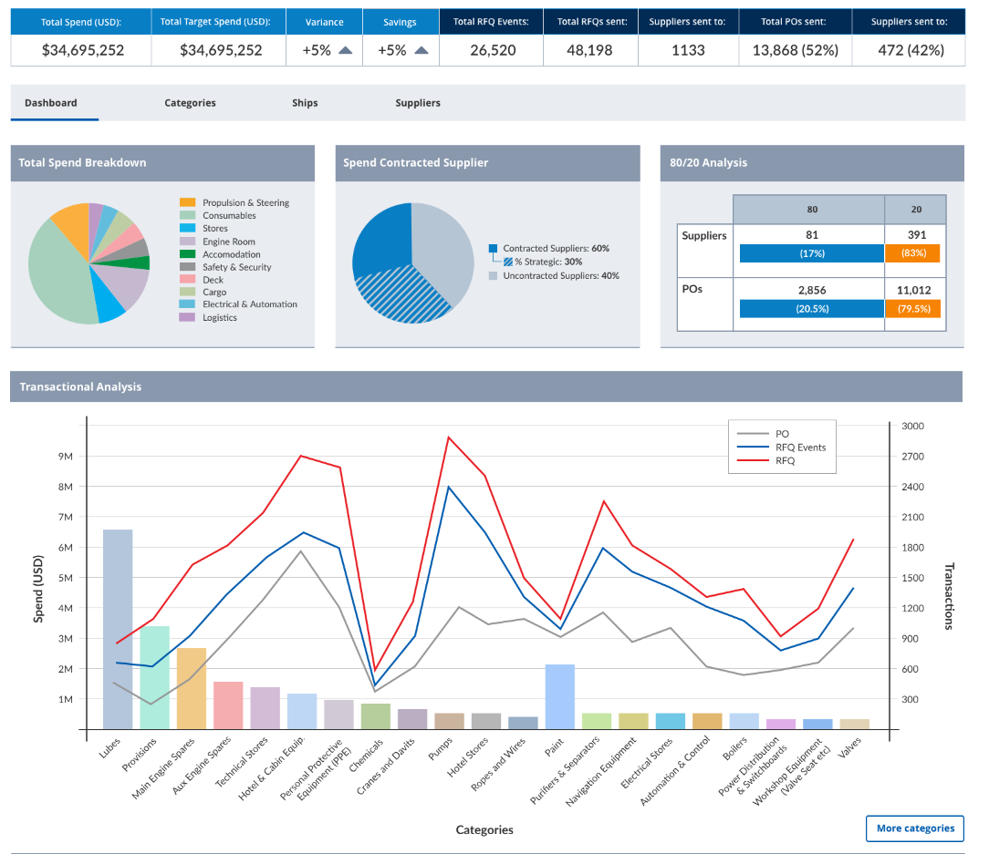
Spend analytics report
Notes:
https://projects.invisionapp.com/share/SHE4KXUFJ#/screens/260061082

Slide 18
Buyer Side Reporting

Slide 19
IMPA Benchmarking Tools
Available NOW
IMPA Spend Tracker
IMPA Price Benchmark
Shows buyer what they are spending on IMPA coded products
Identifies those where they are paying above market average prices
Drilldown to analyse spend on a specific IMPA coded product
Analyse by price, time and supplier location
Provides supplier recommendations
Usefulness of tools determined by how consistently buyer uses IMPA coding system

Slide 20
Supplier Performance Report
Available Now
On demand ‘dossier’ on any of your suppliers that you trade with via ShipServ
Can be printed into 1 report
Use for supplier negotiations and audit purposes
Benchmarked against the overall supplier community

Slide 21
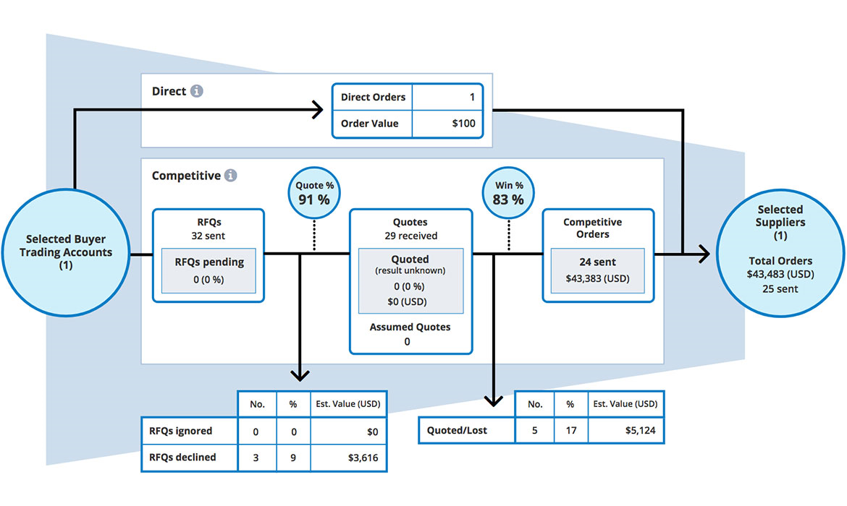
Funnel view
Funnel report is selected
Number of Direct Orders and USD value
Competitiveness. Number of RFQs, Quotes and win / loss ratio
Notes:
-

Slide 22
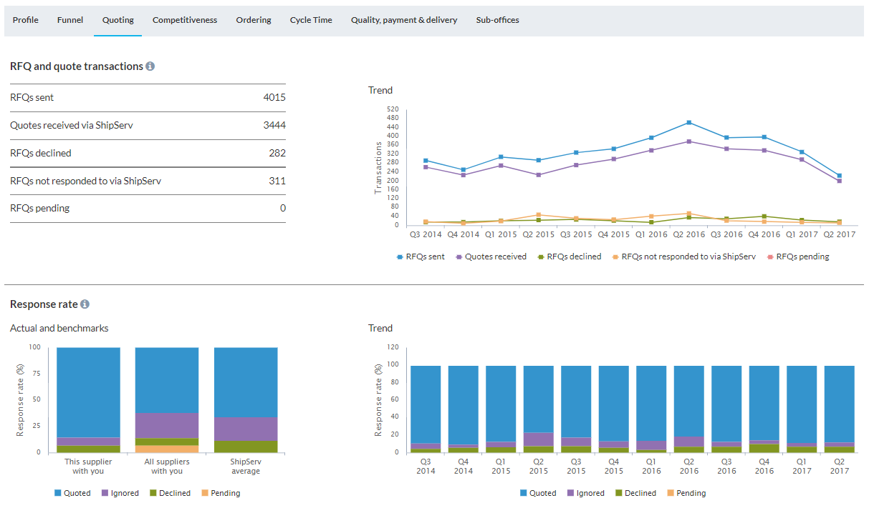
RFQ & Quote Transaction Numbers
Quoting report is selected
Response Rates
Notes:
-

Slide 23
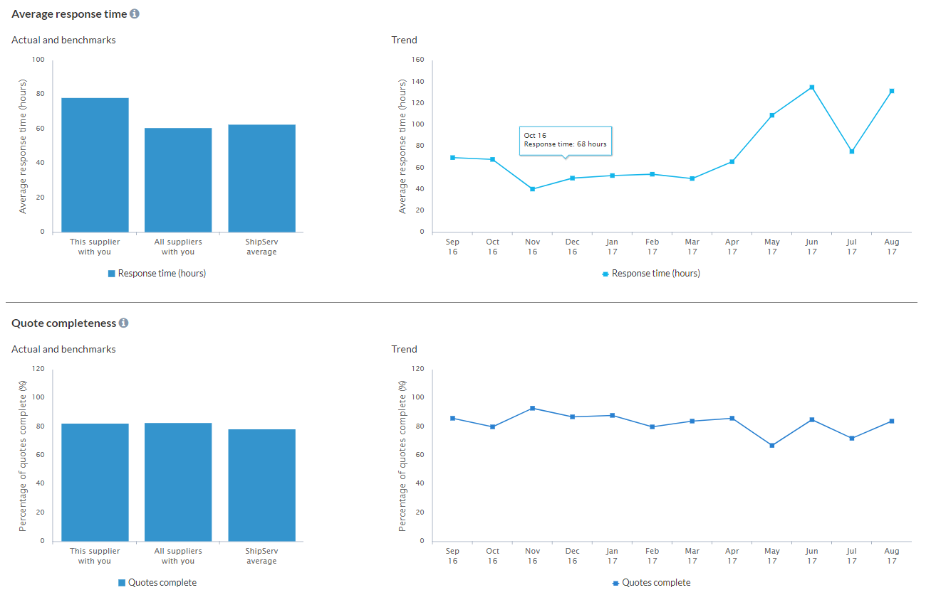
Scroll down the Quoting report page
Average Response Times
Quote Completeness
Notes:
-

Slide 24
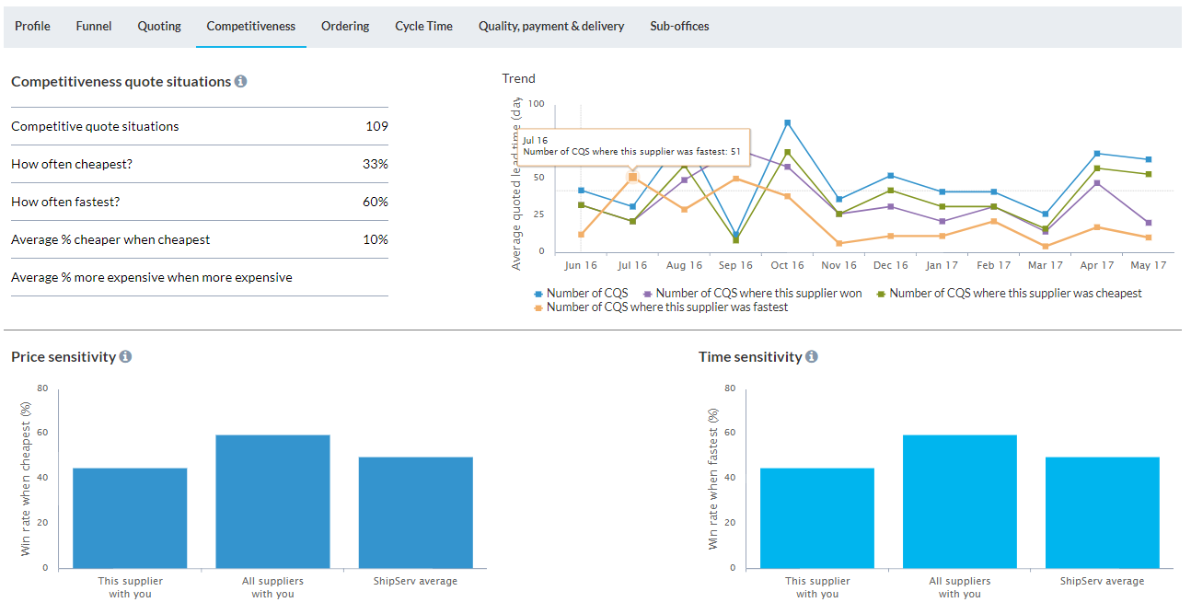
Competitiveness selected
Numbers and breakdown of competitiveness situations
Price sensitivity win rate
Time sensitivity win rate

Slide 25
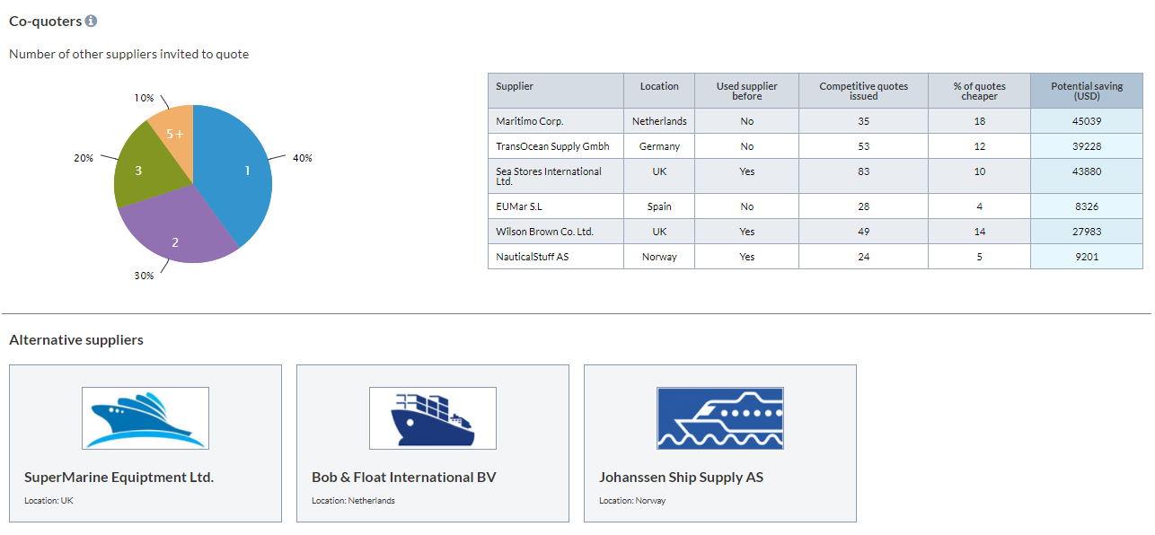
Scroll down the page
Numbers of co-quoters
Alternative suppliers

Slide 26
Notes:
- Show a screenshot if relevant with call outs
- How does the customer access it?
- Any important limitations?

Slide 27
Powered by ShipServ

Slide 28
Implement or reuse existing solution to drive value… and drive industry wide digitalization
ShipServ
Consortium Solution
Consortia
Supported Fleet
Consortia
Opportunity
XX+ vessels
US$XX+ million spend
Sourcing & Supply chain strategy
Drive value from “messy” or structure spend data
Supplier compliance programs
Accelerate and secure sourcing opportunities

Slide 29
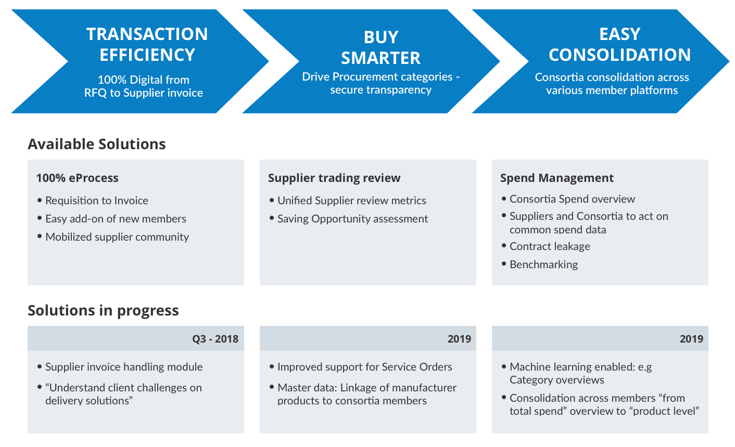
Technical Solution overview

Slide 30
Questions?

Slide 31
Appendix Screen shots from the Spend Analytics tool

Slide 32
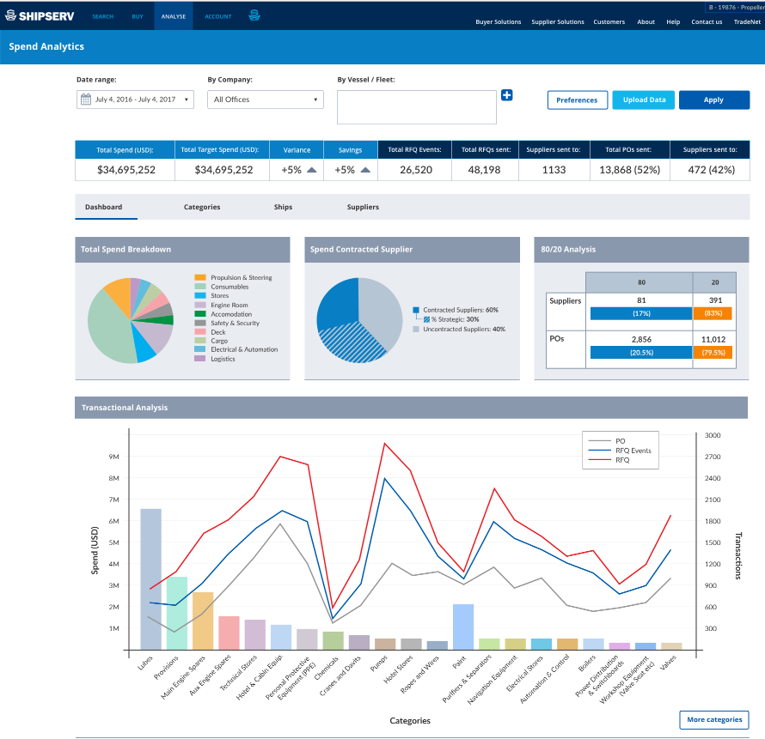

Slide 33
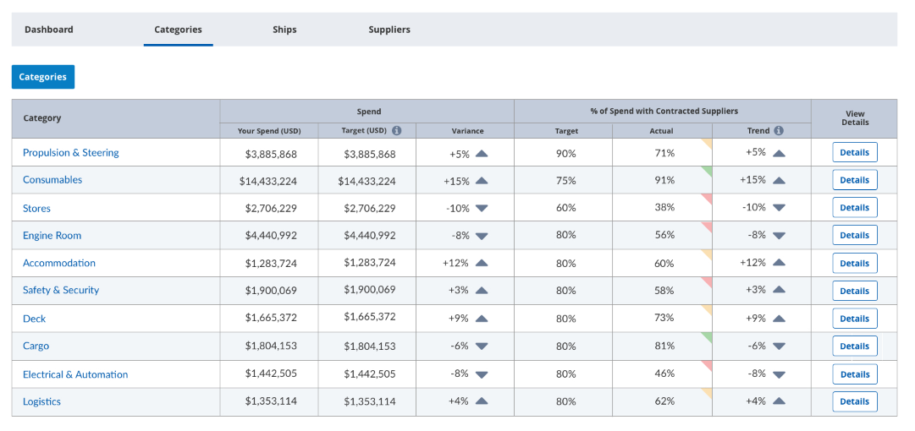

Slide 35
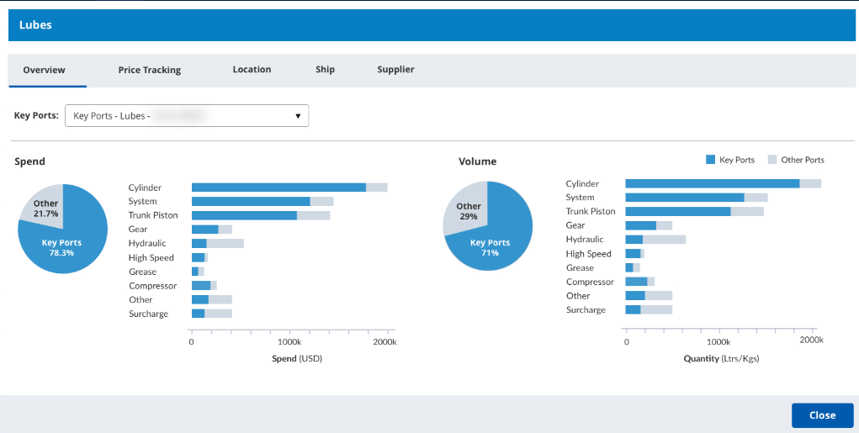

Slide 36
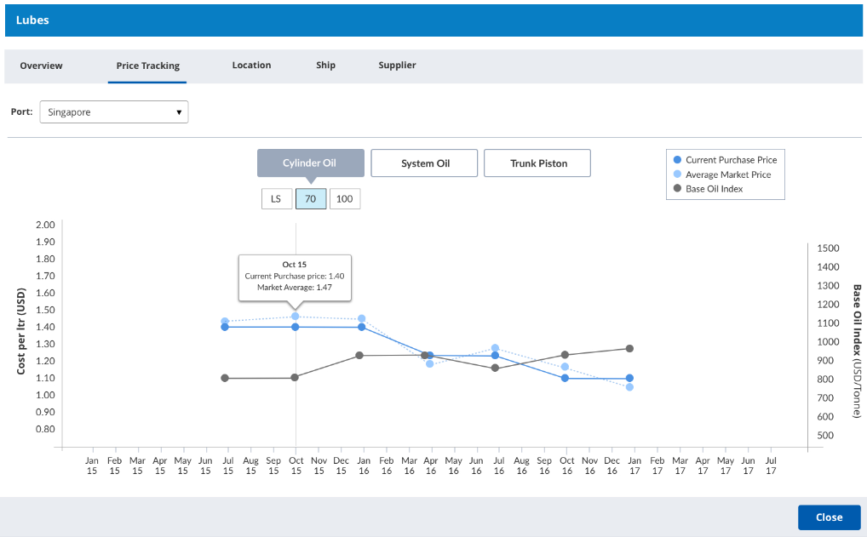

Slide 37
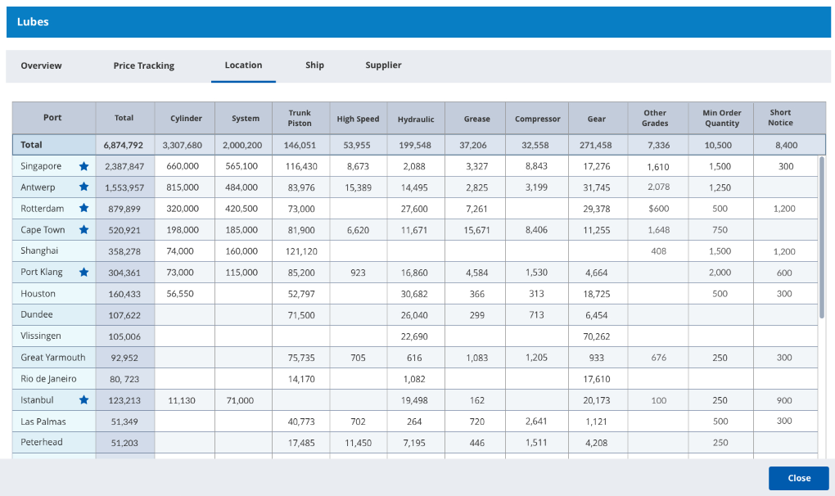

Slide 38
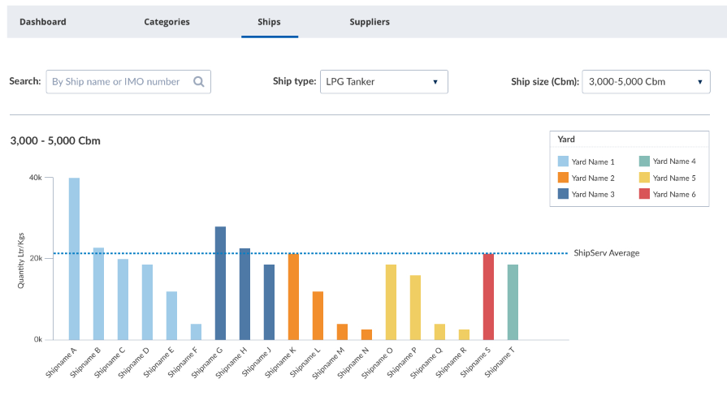

Slide 39
