Slide 1
SAFETY THROUGH KNOWLEDGE
Best Seafarers DNA
London, 05th February 2018 Roger Ringstad Managing Director Seagull Maritime AS

Slide 2
How do we find
The best seafarers
In the world?

Slide 3
Career Development and on-the-job training
Notes:
We are still best known as provider of e-learning and training material for onboard use
During the last 10 years, we have worked together with around 50 ship owners and managers to assist with development of career development system focusing on verifying individual seafarers have the required skills and knowledge in current and next rank. The most important location for training and learning is onboard on-the-job training. We also see that having a robust recruitment and evaluation process helps any organisations to employ the best talents

Slide 4
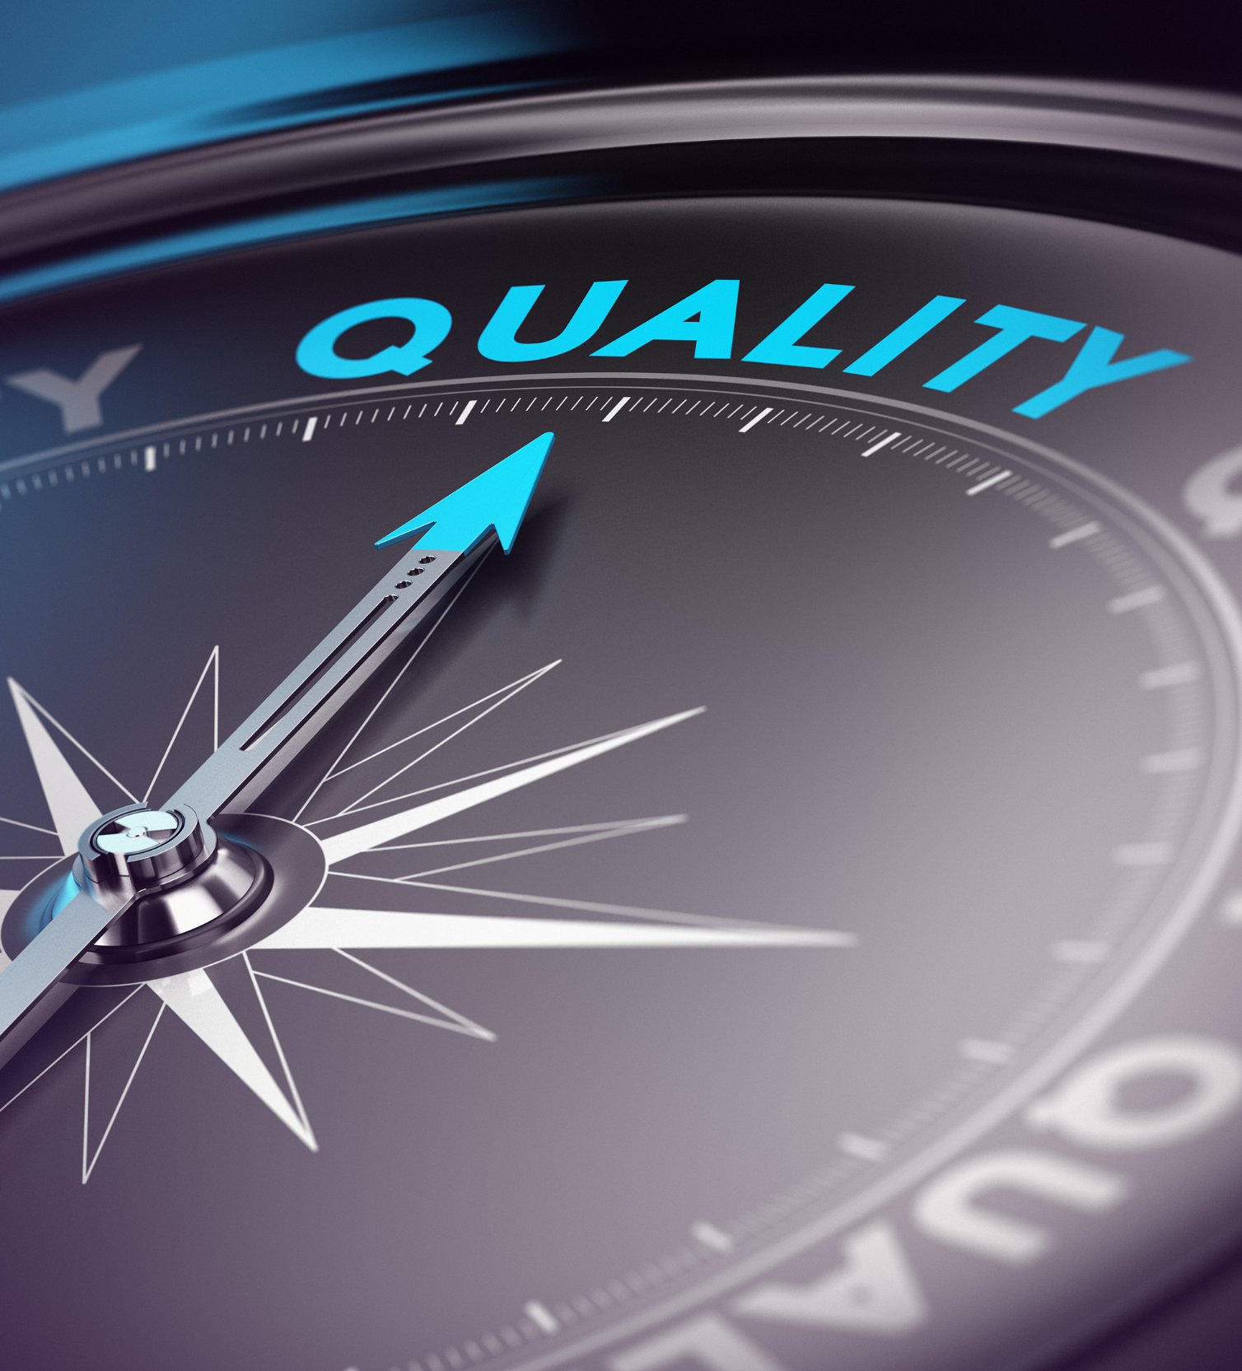
Our Approach and tests
Professional knowledge
Ability
Personality
We have collected and analyzed large number of test results
We focus on Captain / Master role

Slide 5
Knowledge (STCW and Operational subjects)
More than 1,3 million test results
Based on the most commonly used knowledge assessment tool in the maritime industry with 350+ companies using it today
35.000+ test results added to the statistical database every month
6000 Multiple choice questions structured according to STCW, divided in 200+ question groups. Updated every quarter

Slide 6
Knowledge test
Management level tests performed by 9600+ Captains which is directly relevant for this project
Management level contains 90 questions tailored to department and vessel types
Score per rank per nationality
Statistics also enable benchmarking for individual companies comparing with industry

Slide 7
Testing of
mental capabilities
and
behavioural styles

Slide 8
APRO – Ability PROifling
Developed by University of Oslo, Norway tailored to Shipping Industry piloted by 6 Ship Owners from 1998 – 2002 before it was revised and commercialized
A psychometric test designed to objectively assess individual differences in abilities believed to be important in order to develop safety, reliability and quality in different kind of ship operations.
APRO is fundamentally all about the measure of speed versus accuracy. Speed is the response time whereas accuracy is related to the number or percentage of incorrect responses

Slide 9
APRO – Ability PROifling
For this project we have used test results from more than 20.000 individuals
First version was Launched 1998 with a reference group of 500 Maritime college students from Philippines.
In 2015 the reference group was extended to 9000+ test results with all ranks and largest nationalities (Seafarers)

Slide 10
Testing of personal
characteristics
Notes:
The third testing program has been personality testing program. For the last 3 years we have looked into several personality tests used by shipping companies and also some which is large outside the maritime world. We where looking for a program which have large user base, is as far as possible neutral to culture and language, and has strong reporting capabilities. We concluded with the program Facet5 which was introduced to you during last presentation
We have also tested this program with a handful of large Ship Operators during the last year to get first hand experience with correlation between test profiles and top performers

Slide 11
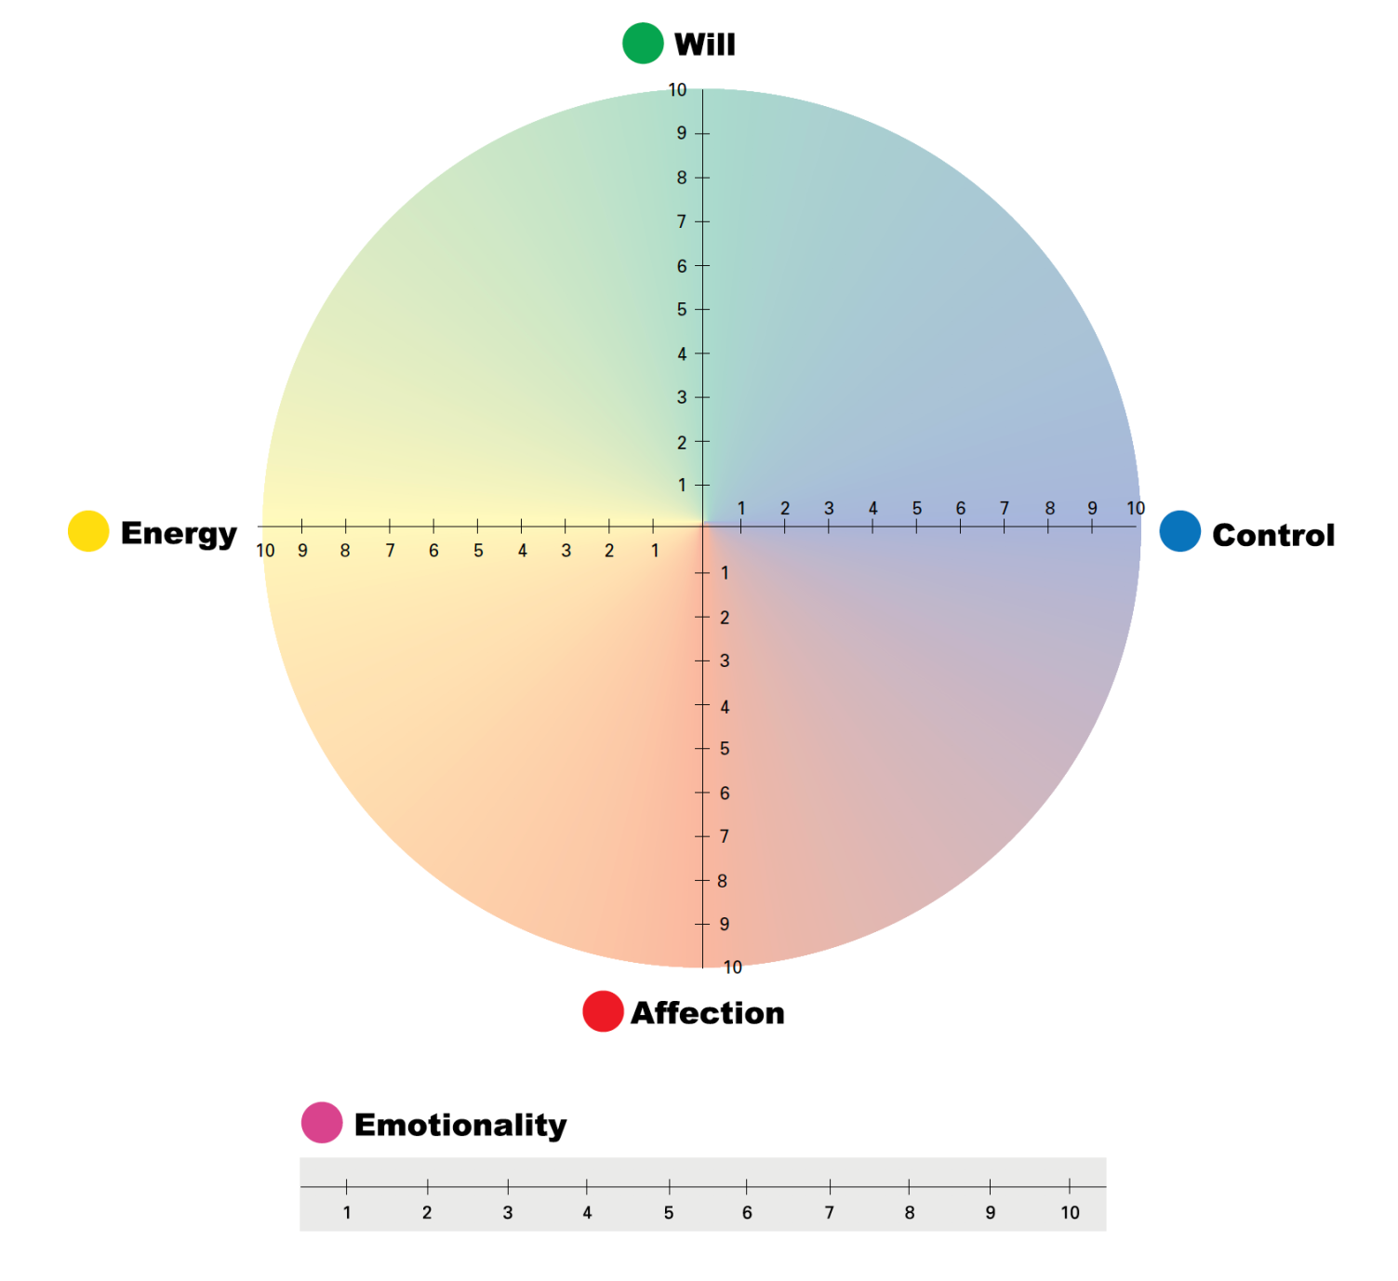
Facet5
Based The five factor model of personality (or ‘Big 5’) is now widely accepted as the best way of describing the fundamental building blocks of personality
Measure strength, risk, work preferences, motivators and de-motivators
30+ languages and 40+ country based Norms
Certified by DNV GL and BPS (British Psychological Society)

Slide 12
Top Performers – Facet5
Two Ship Owners
100+ Container Vessels
30+ Tankers (Oil Major)
Identified their top performers (Captains and Chief Engineers) which has then completed Facet5
20+ Individuals from each rank from each company
Illustrations show personality profile for first tests from each company
So far we see identical profiles for tests performed by same rank

Slide 13
So, what is
the DNA of
the worlds
best seafarer?

Slide 14
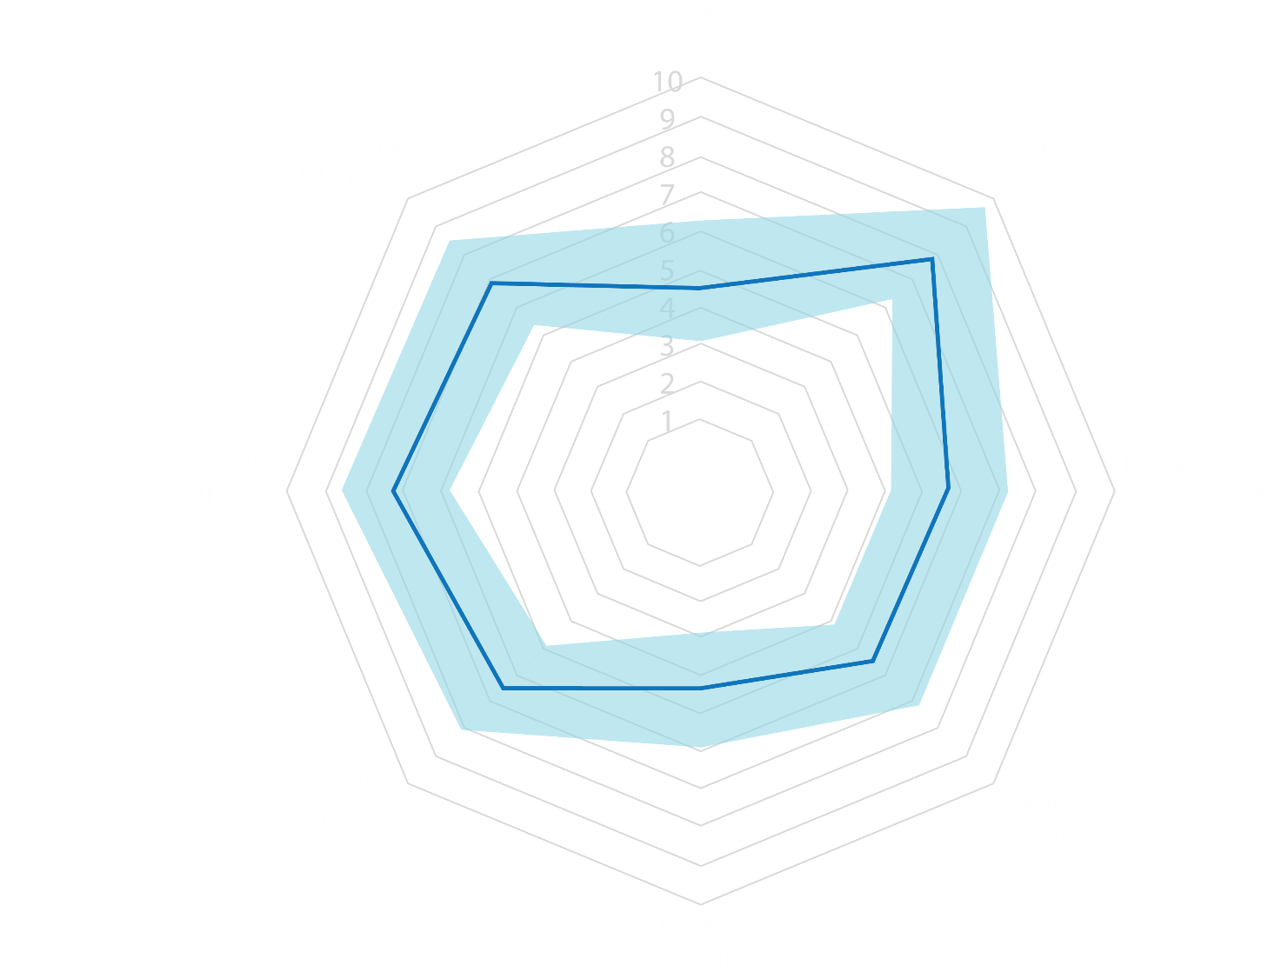
Best seafarer DNA
Knowledge – Ability – Personality
Visual presentation of all test results
Average score for Captains
Captain candidates should match this profile

Slide 15
The best organizations don’t hire superstars – they build them

